Slide 1
BEING FOUND FAITHFUL!!
REFLECTING THE IMAGE OF JESUS CHRIST PERFECTLY THE GOAL

Slide 2





EW 63.2
There are many precious truths contained in the Word of God, but it is "present truth" that the flock needs now. I have seen the danger of the messengers running off from the important points of present truth, to dwell upon subjects that are not calculated to unite the flock and sanctify the soul.

Slide 3
Revelation 14:12
Here is the patience of the saints: here are they that keep the commandments of God, and the faith of Jesus.
You can’t keep what you never had!
Jesus’ faith in His Father is what made Him faithful unto death!
There can be no keeping of the commandments in my strength!
Notes:
So, is there a relationship between both? (i.e. Keeping the commandments and the Faith of Jesus) // (Synonymous nouns): Confidence, trust, reliance, conviction, belief, assurance. // Devotion, loyalty, faithfulness, commitment, fidelity, constancy, fealty, dedication, allegiance, belief.

Slide 4
Revelation 14:12
There can not even be the desire to keep the commandments if there is no love for Jesus – and how do we show love for Jesus? John 14:15
So, to be found faithful we must have a solid relationship with Jesus Christ, through whom alone we can overcome sin and vindicate God’s character.
Notes:
So, is there a relationship between both? (i.e. Keeping the commandments and the Faith of Jesus) // (Synonymous nouns): Confidence, trust, reliance, conviction, belief, assurance. // Devotion, loyalty, faithfulness, commitment, fidelity, constancy, fealty, dedication, allegiance, belief.

Slide 5
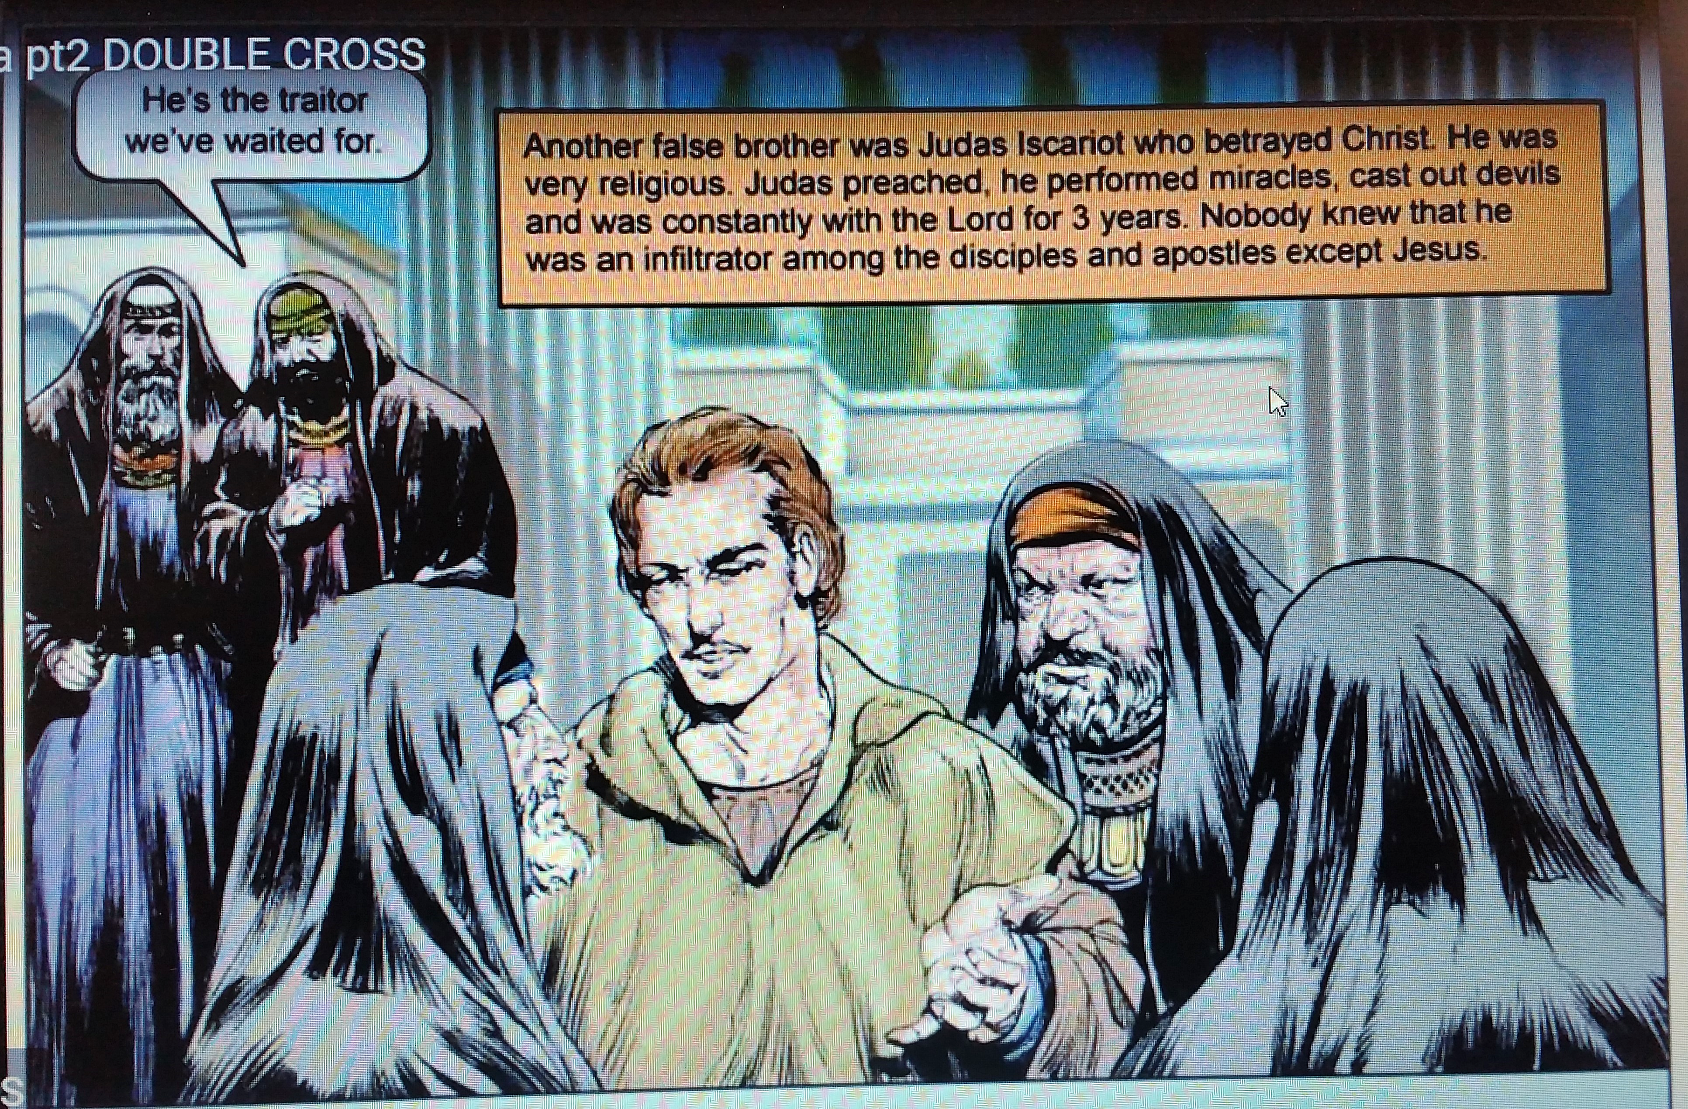
TYPE, ANTITYPE?
*
Notes:
* While Jesus was preparing the disciples for their ordination, one who had not been summoned urged his presence among them. It was Judas Iscariot, a man who professed to be a follower of Christ. . . . Judas believed Jesus to be the Messiah; and by joining the apostles, he hoped to secure a high position in the new kingdom. . . . {CC 285.2} The disciples were anxious that Judas should become one of their number. He was of commanding appearance, a man of keen discernment and executive ability, and they commended him to Jesus as one who would greatly assist Him in His work. . . . The after history of Judas would show them the danger of allowing any worldly consideration to have weight in deciding the fitness of men for the work of God. . . . {CC 285.3} // WAS JUDAS A TYPE OF A MODERN DAY – JESUIT – INFILTRATOR? WAS HE A TYPE OF THOSE WHO WILL BETRAY JESUS IN THE PERSON OF HIS SAINTS?

Slide 6
MATTHEW 24:10
And then shall many be offended, and shall betray one another, and shall hate one another.
Notes:
1 Cor. 10:11

Slide 7
SR (The Story of Redemption) 216.2
Judas, overwhelmed with anguish, threw the money that he now despised at the feet of those who had hired him, and, in anguish and horror, went and hanged himself.
*
Notes:
*EACH OF US MUST ASK THE QUESTION: AM I FAITHFUL TO MY LORD AND SAVIOUR JESUS CHRIST? OR, AM I BETRAYING HIM FOR MONEY, POSITION, WORLDLY HONOUR, FAME – IOW FOR SELF GRATIFICATION. / AM I PREPARING TO HANG MYSELF? HOW MANY WILL END UP “HANGING” THEMSELVES IN THE ANTITYPE?

Slide 8
GC88 Chap. 2 p. 44
Our Saviour taught that those who willfully indulge in sin are not to be received into the church; yet he connected with himself men who are faulty in character, and granted them the benefits of his teachings and example, that they might have an opportunity to see their errors and correct them. Among the twelve apostles was a traitor.
*
Notes:
Am I a traitor in the church? Just awaiting the opportune time? Am I preparing myself to be a traitor and don’t even know it? How is that possible?

Slide 9
GC88 Chap. 2 p. 44
Judas was accepted not because of his defects of character, but notwithstanding them. He was connected with the disciples, that, through the instruction and example of Christ, he might learn what constitutes Christian character, and thus be led to see his errors, to repent, and, by the aid of divine grace, to purify his soul “in obeying the truth.”
*
Notes:
Am I a traitor in the church? Just awaiting the opportune time? Am I preparing myself to be a traitor and don’t even know it? How is that possible?

Slide 10
But Judas did not walk in the light so graciously permitted to shine upon him. By indulgence in sin, he invited the temptations of Satan. His evil traits of character became predominant. He yielded his mind to the control of the powers of darkness, he became angry when his faults were reproved, and thus he was led to commit the fearful crime of betraying his Master.
*
Notes:
Am I indulging in sin? Am I setting myself up to be unfaithful? To betray Jesus Christ? // Am I secretly cherishing iniquity? Am I planning and carrying out sin secretly? What might “secret” sins be? The things we do that we know are not right that we hide from the brethren – and clean them up and come to church looking all righteous and sanctimonious? Is it fornication? Is it adultery? Is it maturation? Is it imbibing rock music? Smoking? Drinking? Is it envying? Backbiting / stabbing people in the back / killing their character? Looking at pornography? Watching demon inspired cartoons? Is it anger? Is it watching the Soap Operas? Is it lying? Stealing? Is it a spirit of bitterness and un-forgiveness? Am I taking God’s name in vain? Am I worshipping and bowing down to graven images? Am I rejecting God and accepting another god? Perhaps the God called “SELF”? Or, some other God? OR, AM I FAITHFUL IN ALL THINGS? DEAR JESUS AND OUR HEAVELY FATHER! HELP US! LORD!! TO BE FOUND FAITHFUL!!

Slide 11
So do all who cherish evil under a profession of godliness hate those who disturb their peace by condemning their course of sin. When a favourable opportunity is presented, they will, like Judas, betray those who for their good have sought to reprove them. The apostles encountered those in the church who professed godliness while they were secretly cherishing iniquity. GC88 43.2
*
Notes:
Am I indulging in sin? Am I setting myself up to be unfaithful? To betray Jesus Christ? // Am I secretly cherishing iniquity? Am I planning and carrying out sin secretly? What might “secret” sins be? The things we do that we know are not right that we hide from the brethren – and clean them up and come to church looking all righteous and sanctimonious? Is it fornication? Is it adultery? Is it maturation? Is it imbibing rock music? Smoking? Drinking? Is it envying? Backbiting / stabbing people in the back / killing their character? Looking at pornography? Watching demon inspired cartoons? Is it anger? Is it watching the Soap Operas? Is it lying? Stealing? Is it a spirit of bitterness and un-forgiveness? Am I taking God’s name in vain? Am I worshipping and bowing down to graven images? Am I rejecting God and accepting another god? Perhaps the God called “SELF”? Or, some other God? OR, AM I FAITHFUL IN ALL THINGS? DEAR JESUS AND OUR HEAVELY FATHER! HELP US! LORD!! TO BE FOUND FAITHFUL!!

Slide 12

WHAT DOES JESUS SEE IN ME?
The bodies of human beings, made for the dwelling place of God, had become the habitation of demons. The senses, the nerves, the passions, the organs of men, were worked by supernatural agencies in the indulgence of the vilest lust.

Slide 13
WHAT DOES JESUS SEE IN ME?
The very stamp of demons was impressed upon the countenances of men. Human faces reflected the expression of the legions of evil with which they were possessed. Such was the prospect upon which the world's Redeemer looked. What a spectacle for Infinite Purity to behold! {DA 36.3}

Slide 14
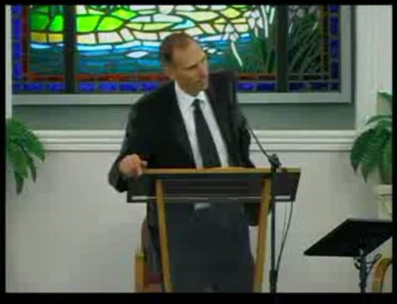

Slide 15
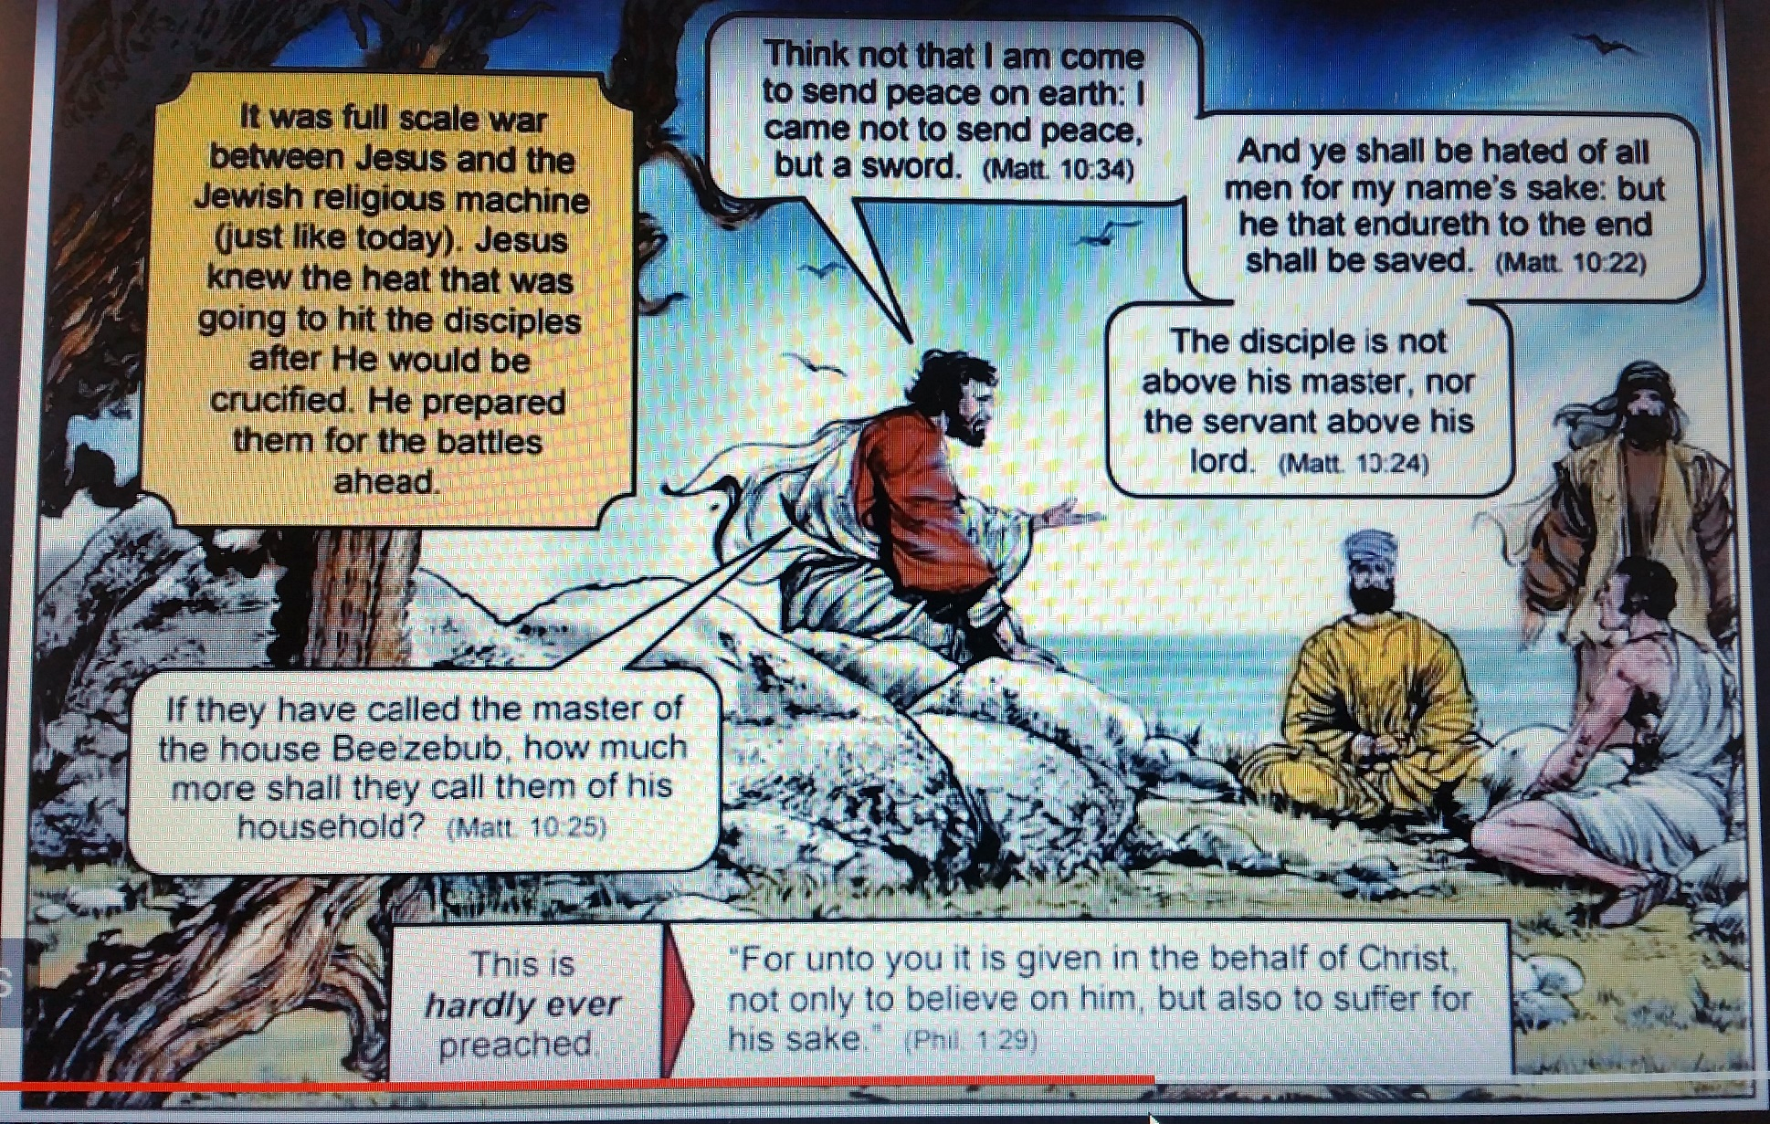
JESUS DID EVERYTHING TO PREPARE HIS DISCIPLES FOR THE CRISIS THEY WOULD FACE
*
Notes:
IF WE AR NOT WILLING TO GIVE UP SIN BUT INSTEAD REMAIN REBELLIOUS AGAINST JESUS’ DOCTRINE WHAT WILL HAPPEN TO US IF WE ARE ALIVE WHEN THE FINAL TEST COMES? Revelation 12:17 And the dragon was wroth with the woman, and went to make war with the remnant of her seed, which keep the commandments of God, and have the testimony of Jesus Christ. NO JOKE ABOUT IT THIS IS A WAR!! --- MARTYRDOM BY BEHEADING IS COMING!! WILL WE REMAIN FAITHFUL?? // Matthew 24:9 Then shall they deliver you up to be afflicted, and shall kill you: and ye shall be hated of all nations for my name's sake. // Rev. 6:9 – 11, 12:11, 13:8, 17:8, etc.

Slide 16
REQUIREMENTS OF FAITHFULNESS
WHAT WE ARE TO BE DOING?
DAY OF ATONEMENT
HAVE HOLY CONVOCATION
**AFFLICTING OUR SOULS
OFFER AN OFFERING MADE BY FIRE UNTO THE LORD
DO NO WORK…FOR IT IS A DAY OF ATONEMENT
Stopped here SVSDAC 2017 12 09
Notes:
EACH SABBATH IS A TEST.
WE MUST HUMBLE OURSELVES BEFORE GOD. DEEP SELF EXAMINATION IS NECESSARY. Matthew 5:29, 30.
WE NEED TO GIVE UP EVERYTHING TO GOD AS A SACRIFICE / SACRIFICE ALL FOR GOD – FOR OUR SOUL’S SALVATION. Romans 12:1
WE CANNOT PERFORM ANY WORK THAT WILL HAVE MERIT FOR OUR SALVATION – FAITH ALONE IN THE ATONING SACRIFICE OF CHRIST / WE ARE TO ENSURE WE DO “NO WORK” / NOTHING THAT IS OFFENSIVE TO GOD. Romans 13:12 / Eph. 5:11

Slide 17
REQUIREMENTS OF FAITHFULNESS
WHAT WE ARE TO BE DOING
DAY OF ATONEMENT
PUT AWAY SIN
Stopped here SVSDAC 2017 12 09
Notes:
WHAT’S THE AIM / PURPOSE OF THE FOREGOING?...?
5. Put – Away – Sin: Ephesians 5:25 – 27; Rev. 22:14, 15; Matt. 5:48; 1 Peter 1:16 (Lev. 11:44, 45); Gal. 2:20; 2 Cor. 5:17; Rev. 12:17 & 14:12; Hebrews 7:25, etc.

Slide 18
Living in the Great Day of Atonement
We are now living in the great day of atonement. In the typical service, while the high priest was making the atonement for Israel, all were required to afflict their souls by repentance of sin and humiliation before the Lord, lest they be cut off from among the people.

Slide 19
Living in the Great Day of Atonement
In like manner, all who would have their names retained in the book of life should now, in the few remaining days of their probation, afflict their souls before God by sorrow for sin and true repentance. There must be deep, faithful searching of heart. The light, frivolous spirit indulged by so many professed Christians must be put away.

Slide 20
An individual work of preparation
There is earnest warfare before all who would subdue the evil tendencies that strive for the mastery. The work of preparation is an individual work. We are not saved in groups.
*
Notes:
Ephesians 5:27 (KJV) That he might present it to himself a glorious church, not having spot, or wrinkle, or any such thing; but that it should be holy and without blemish.

Slide 21
An individual work of preparation
The purity and devotion of one will not offset the want of these qualities in another. Though all nations are to pass in judgment before God, yet He will examine the case of each individual with as close and searching scrutiny as if there were not another being upon the earth. Everyone must be tested and found without spot or wrinkle or any such thing. {LHU 330.2}
*
Notes:
Ephesians 5:27 (KJV) That he might present it to himself a glorious church, not having spot, or wrinkle, or any such thing; but that it should be holy and without blemish.

Slide 22
Watch and Pray
Solemn are the scenes connected with the closing work of the atonement. Momentous are the interests involved therein. The judgment is now passing in the sanctuary above. For many years this work has been in progress. Soon--none know how soon--it will pass to the cases of the living.
*
Notes:
Revelation 22:11,12 / WHAT TIME IS IT WE DON’T KNOW WHEN? / SPECIFICALLY, WE DON’T KNOW WHEN OUR INDIVIDUAL RECORD WILL COME UP FOR JUDGMENT! / SOLEMN INDEED!!

Slide 23
Watch and Pray
In the awful presence of God our lives are to come up in review. At this time above all others it behooves every soul to heed the Saviour's admonition: "Watch and pray: for ye know not when the time is" (Mark 13:33).
*
Notes:
Revelation 22:11,12 / WHAT TIME IS IT WE DON’T KNOW WHEN? / SPECIFICALLY, WE DON’T KNOW WHEN OUR INDIVIDUAL RECORD WILL COME UP FOR JUDGMENT! / SOLEMN INDEED!!

Slide 24
AM I FAITHFUL?
KINGDOM LIVING
MOST HOLY PLACE EXPERIENCE
REVIVAL AND REFORMATION – TOTAL TRANSFORMATION
**SABBATH REFORM
HEALTH REFORM - LIFESTYLE DIET DRESS
MUSIC REFORM
**LOCATION REFORM – COUNTRY LIVING

Slide 25
COUNTRY LIVING
It was not God's purpose that His people should be crowded into cities, huddled together in terraces and tenements. In the beginning He placed our first parents in a garden amidst the beautiful sights and attractive sounds of nature, and these sights and sounds He desires men to rejoice in today.

Slide 26
Take your families from the cities
Light has been given me that the cities will be filled with confusion, violence, and crime, and that these things will increase till the end of this earth's history. {Mar 141.3}
It is time for our people to take their families from the cities into more retired localities, else many of the youth, and many also of those older in years, will be ensnared and taken by the enemy. {Mar 141.4}
"Out of the cities; out of the cities!"--this is the message the Lord has been giving me. {Mar 141.5}
Notes:
IN A WAR LOCATION IS KEY. OFTENTIMES WHERE YOU ARE AT THE TIME OF THE BATTLE DETERMINES WHETHER YOU WIN OR LOSE. WHETHER YOU LIVE OR DIE! WILL WE BE FOUND FAITHFUL IN OBEYING THIS COMMAND OF JESUS? WHAT WILL HAPPEN IF WE ARE FOUND IN DISOBEDIENCE? WHAT WILL HAPPEN TO US IF WE DO NOT FIND OURSELVES WHERE JESUS SAID WE ARE TO BE? WHAT HAPPENED TO THOSE WHO REMAINED IN JERUSALEM IN AD 70? WAS JESUS AT THE RIGHT PLACES AT THE RIGHT TIMES THROUGHOUT HIS LIFE? DID HE FOLLOW THE WILL OF HIS FATHER? DID HE STUDY THE TYPES AND THE PROPHECIES AND KNEW WHERE HE SHOULD BE AND WHAT HE SHOULD BE DOING EVERY STEP OF THE WAY? HE IS THE ULTIMATE TYPE AND ANTITYPE – HE IS IN THE MOST HOLY PLACE NOW – RIGHT PLACE / HE WILL BE OUT AT A SET TIME / HE WILL COME BACK AT A SET TIME FROM A SET PLACE.

Slide 27
THE BROOM!
The ungodly cities of our world are to be swept away by the besom of destruction.
In the calamities that are now befalling immense buildings and large portions of cities God is showing us what will come upon the whole earth.
Notes:
Besom - a broom. especially one of brush or twigs.

Slide 28
Outposts
The truth must be spoken, whether men will hear, or whether men will forbear. The cities are filled with temptation. We should plan our work in such a way as to keep our young people as far as possible from this contamination. {CL 30.1}

Slide 29
Outposts
The cities are to be worked from outposts. Said the messenger of God, "Shall not the cities be warned? Yes; not by God's people living in them, but by their visiting them, to warn them of what is coming upon the earth."--Letter 182, 1902.

Slide 30
EXAMPLE OF ENOCH
As God's commandment-keeping people, we must leave the cities. As did Enoch, we must work in the cities but not dwell in them.– Evangelism, pp. 78, 79. (1899) {CL 30.4} When iniquity abounds in a nation, there is always to be heard some voice giving warning and instruction, as the voice of Lot was heard in Sodom.

Slide 31
EXAMPLE OF ENOCH
Yet Lot could have preserved his family from many evils, had he not made his home in this wicked, polluted city. All that Lot and his family did in Sodom could have been done by them, even if they had lived in a place some distance away from the city. Enoch walked with God, and yet he did not live in the midst of any city, polluted with every kind of violence and wickedness, as did Lot in Sodom.--Evangelism, p. 79. (1903) {CL 30.5}

Slide 32
The Signal for Fleeing
It is no time now for God's people to be fixing their affections or laying up their treasure in the world. The time is not far distant, when, like the early disciples, we shall be forced to seek a refuge in desolate and solitary places. As the siege of Jerusalem by the Roman armies was the signal for flight to the Judean Christians, so the assumption of power on the part of our nation, in the decree enforcing the papal sabbath, will be a warning to us.

Slide 33
The Signal for Fleeing
It will then be time to leave the large cities, preparatory to leaving the smaller ones for retired homes in secluded places among the mountains. And now, instead of seeking expensive dwellings here, we should be preparing to move to a better country, even a heavenly. Instead of spending our means in self-gratification, we should be studying to economize.-- Testimonies, vol. 5, pp. 464, 465. (1885) {CL 32.1}

Slide 34
THE GREAT CONTROVESY – TYPES:
BATTLES IN THE FINAL DAYS
LUKE 4:
³¹ And came down to Capernaum, a city of Galilee, and taught them on the sabbath days.
³² And they were astonished at his doctrine: for his word was with power.
³³ And in the synagogue there was a man, which had a spirit of an unclean devil, and cried out with a loud voice,
³⁴ Saying, Let us alone; what have we to do with thee, thou Jesus of Nazareth? art thou come to destroy us? I know thee who thou art; the Holy One of God.
*
Notes:
*CONTEXT / BACKGROUND: Luke 4:14 – 30. /

Slide 35
THE GREAT CONTROVESY – TYPES:
THE BATTLE IS FOR THE MIND!
LUKE 4:
³⁵ And Jesus rebuked him, saying, Hold thy peace, and come out of him. And when the devil had thrown him in the midst, he came out of him, and hurt him not.
³⁶ And they were all amazed, and spake among themselves, saying, What a word is this! for with authority and power he commandeth the unclean spirits, and they come out.
³⁷ And the fame of him went out into every place of the country round about.
*
Notes:
*CONTEXT / BACKGROUND: Luke 4:14 – 30. When we as God’s people get victory over Satan’s hold on us – Then we will be able to participate in the loud cry of lifting up Jesus to the world! John 12: 32 And I, if I be lifted up from the earth, will draw all men unto me.

Slide 36
THE GREAT CONTROVERSY - THE CONTRAST
Jesus watched with deep earnestness the changing countenances of His hearers. The faces that expressed interest and pleasure gave Him great satisfaction. As the arrows of truth pierced to the soul, breaking through the barriers of selfishness, and working contrition, and finally gratitude, the Saviour was made glad. When His eye swept over the throng of listeners, and He recognized among them the faces He had before seen, His countenance lighted up with joy. He saw in them hopeful subjects for His kingdom.
When the truth, plainly spoken, touched some cherished idol, He marked the change of countenance, the cold, forbidding look, which told that the light was unwelcome. When He saw men refuse the message of peace, His heart was pierced to the very depths. {DA 255.1}

Slide 37
THE GREAT CONTROVERSY - SATAN’S INTERRUPTION
Jesus in the synagogue spoke of the kingdom He had come to establish, and of His mission to set free the captives of Satan. He was interrupted by a shriek of terror. A madman rushed forward from among the people, crying out, "Let us alone; what have we to do with Thee, Thou Jesus of Nazareth? art Thou come to destroy us? I know Thee who Thou art; the Holy One of God." {DA 255.2}

Slide 38
THE GREAT CONTROVERSY - SATAN’S INTERRUPTION
All was now confusion and alarm. The attention of the people was diverted from Christ, and His words were unheeded. This was Satan's purpose in leading his victim to the synagogue. But Jesus rebuked the demon, saying, "Hold thy peace, and come out of him. And when the devil had thrown him in the midst, he came out of him, and hurt him not."{DA 255.3}

Slide 39
The Great Controversy – God’s Way or My Way?
The secret cause of the affliction that had made this man a fearful spectacle to his friends and a burden to himself was in his own life. He had been fascinated by the pleasures of sin, and had thought to make life a grand carnival. He did not dream of becoming a terror to the world and the reproach of his family.

Slide 40
The Great Controversy – God’s Way or My Way?
He thought his time could be spent in innocent folly. But once in the downward path, his feet rapidly descended. Intemperance and frivolity perverted the noble attributes of his nature, and Satan took absolute control of him. {DA 256.3}

Slide 41
The Great Work
The great work of parents and teachers is character building -- seeking to restore the image of Christ in those placed under their care. A knowledge of the sciences sinks into insignificance beside this great aim; but all true education may be made to help in the development of a righteous character.

Slide 42
The Great Work
The formation of character is the work of a lifetime, and it is for eternity. If all could realize this, and would awake to the fact that we are individually deciding our own destiny and the destinies of our children for eternal life or eternal ruin, what a change would take place! How differently would our probationary time be occupied, and with what noble characters would our world be filled! {CT 61.2}

Slide 43
FAITHFUL PARENTS, FAITHFUL INDIVIDUALS
The question that should come home to each of us is, Upon what foundation am I building? We have the privilege of striving for immortal life; and it is of the greatest importance that we dig deep, removing all the rubbish, and build on the solid rock, Christ Jesus.

Slide 44
REVELATION 14:12
Here is the patience of the saints: here are they that keep the commandments of God, and the faith of Jesus.
You can’t keep what you never had!
Jesus’ faith in His Father is what made Him faithful unto death!
There can be no keeping of the commandments in my strength!
There can be not even the desire to keep the commandments if there is no love for Jesus – and how we show love for Jesus is to keep His commandments!
Notes:
JOHN 14:15

