Slide 1
SETTLING THE SATURDAY – SUNDAY QUESTION-PART 1:
“UNMASKING THE FALSE SABBATH”
Notes:
Intro:
Talk on the ongoing “controversy” over which day is the Sabbath.

Slide 2
2 TIMOTHY 2:15
Paul the Apostle wrote:
“Study to show thyself approved unto God, a workman that needeth not to be ashamed, rightly dividing the word of truth.” KJV
PAUSE

Slide 3
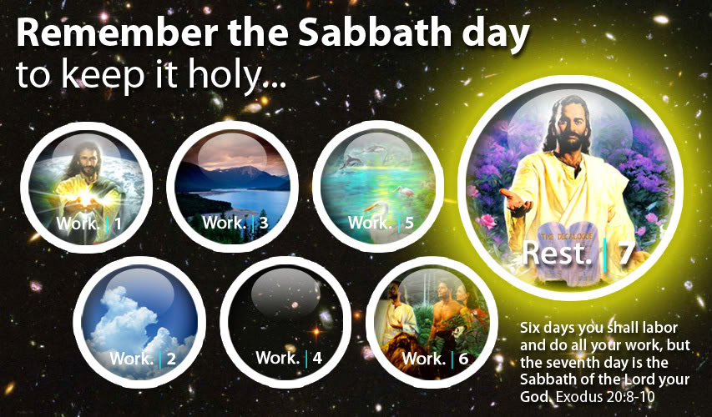
THE BIBLE TELLS US TO:
Light
Land, Sea, Flora
Fish, Birds
Firmament, Waters
Sun, Moon, Stars
Fauna, Man
Genesis 2:2 & 3

Slide 4
(1) “But which day is the seventh day?”

Slide 5
WHO IS IT THAT SAID TO REMEMBER THE DAY
1 In the beginning was the Word, and the Word was with God, and the Word was God.
2 The same was in the beginning with God.
3 All things were made by him; and without him was not any thing made that was made.
14 And the Word was made flesh, and dwelt among us, (and we beheld his glory, the glory as of the only begotten of the Father,) full of grace and truth.
WDJS
(WHAT DID JESUS SAY)
John 14:15
If ye love me, keep my commandments.

Slide 6

SETTLING THE SATURDAY-SUNDAY QUESTION - UNMASKING THE FALSE SABATH
“But which day is the seventh day?”
Response #1:
Bear in mind that the commandment starts with “Remember”.
(A) Saturday is the 7th day. A very popular “nursery rhyme” says: “The days of the week are…” However, in recent times, they are trying to change that with some new calendars, etc.
This is a popular question posed.
A very simple answer.
Notes:
“Remember” suggests that this was something known, The children of Israel knew which day was the Sabbath, the seventh day, because God taught them / reminded / tested them in Exodus 16.

Slide 7
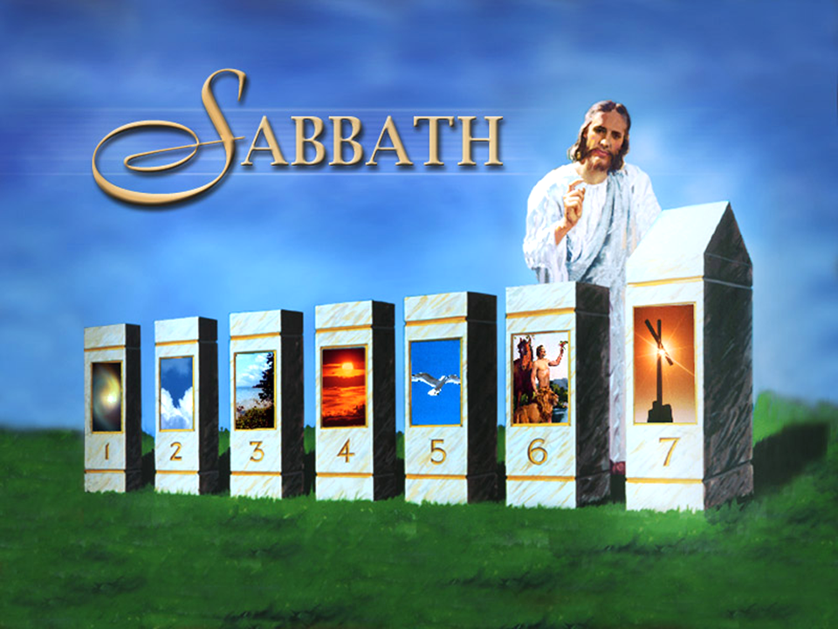
Notes:
The commandment says “seventh day” – It’s as simple as counting! Genesis 1. Creation week. God showed that the 7th day was special so He rested on and blessed the day – Genesis 2:2, 3. In Exodus 16 the seventh day, the Sabbath was special – so no manna fell on that day,

Slide 8

UNMASKING THE FALSE SABATH
“But which day is the seventh day?”
(B) The Bible did not name the days of the week…Genesis mentions “the evening and the morning was the first day”, etc.
However…
Popular question.
Here’s another answer!
Notes:
So, no real names were given to the days – Genesis calls them “evenings and mornings” or “first day”, “second day”, etc. Very simply put, the Sabbath is the 7th day and the 7th day is the one after the sixth and before the first – since the week continues in cycles. (We will look at this more deeply later – So, REMEMBER this).

Slide 9
Notes
Interestingly though, the Bible does “name” two (2) days:
(i) It calls the first “evening and morning” “the first day of the week” in eight (8) instances.
AND, secondly,
(ii) It speaks of the sixth day as “the day of the preparation”, “the preparation” OR “preparation day”.
LET’S LOOK AT THE PREPARATION TEXTS QUICKLY:
We are sure we will have to reveal these texts and explore them later!
Notes:
LET’S SEE HOW THOSE TEXTS RELATE TO AND REVEAL WHICH DAY IS THE SABBATH,

Slide 10
Notes
Matthew 27:62
Now the next day, that followed the day of the preparation, the chief priests and Pharisees came together unto Pilate,
Mark 15:42
And now when the even was come, because it was the preparation, that is, the day before the Sabbath,
Notes:
Jesus died on the 14th day of the first month (Abib) – the Passover, which fell on a Friday, the 6th day of the week – The Pharisees went to Pilate on the Sabbath, the seventh day, to ask that steps be taken to prevent Jesus from getting out of the tomb; Jesus was already dead. Worldwide it is known that Jesus died on a Friday (Jesus’ death is celebrated as “Good Friday”). So, the “Preparation Day” – Is a day we can use as a marker / guide / or signpost to show exactly which day is the seventh day of the week, the Sabbath!

Slide 11
Notes
Luke 23:54
And that day was the preparation, and the Sabbath drew on.
John 19:31
The Jews therefore, because it was the preparation, that the bodies should not remain upon the cross on the Sabbath day, (for that Sabbath day was an high day,) besought Pilate that their legs might be broken, and that they might be taken away.
Notes:
The Feast of Unleavened Bread would be on that 7th day Sabbath – First day of the Feast of Unleavened Bread was a holy day, etc. Exodus 12:15 – 17.

Slide 12
Notes
John 19:42
There laid they Jesus therefore because of the Jews' preparation day; for the sepulchre was nigh at hand.
Note: Otherwise, the naming of the days was done by Pagan Rome; the days were given pagan names.
Note that these texts are in the context of Jesus’ death or crucifixion! We will explore them some more when we look at Part 2: “Revealing the True Sabbath”.

Slide 13
UNMASKING THE FALSE SABATH
What were the names?
1st Day: “Sun’s day” = “Sunday”.
2nd Day: “Moon’s day” = “Monday”.
3rd Day: “Tiw’s day” = “Tuesday”.
4th Day: “Woden’s day” = “Wednesday”.
5th Day: “Thor’s day” = “Thursday”.
6th Day: “Friga’s day” = “Friday”.
7th Day: “Saturn’s day” = “Saturday”.
“But which day is the seventh day?”
Popular question.
Here’s another answer!
Notes:
The days were named by the pagans but the ORDER of the days was NOT CHANGED. (More on that as we go on)
1st Day: “Sun’s day” (Sun Worship) = “Sunday”.
2nd Day: “Moon’s day” (Moon Worship) = “Monday”.
3rd Day: “Tiw’s day” (A false god) = “Tuesday”.
4th Day: “Woden’s day” (god of wood / worship of wood) = “Wednesday”.
5th Day: “Thor’s day” (thor – son of odin / god of thunder) = “Thursday”.
6th Day: “Frigga’s day” (Germanic mythology - goddess, wife of the god odin) = “Friday”.
7th Day: “Saturn’s day” (named after the god saturn) = “Saturday”.
Odin was god of war and death, as well as a sky god and the god of wisdom and poetry. // Woden (wō´dən; German vō´dĬn), Norse Odin (ō´dĬn), in Germanic religion and mythology, the supreme god.
“In ancient Roman religion and myth, Saturn (Latin: Saturnus) was a god of agriculture, liberation, and time. ... Saturn the planet and Saturday are both named after the god.”

Slide 14
UNMASKING THE FALSE SABATH
What were the names? (Some “Brawta”)
Note: The names also corresponded to and were named after the heavenly bodies that were worshipped. So, another naming was:
1st Day: “Sun’s day” = “Sunday”.
2nd Day: “Moon’s day” = “Monday”.
3rd Day: “Mars’ day” = “Tuesday”.
4th Day: “Mercury’s day” = “Wednesday”.
5th Day: “Venus’ day” = “Thursday”.
6th Day: “Jupiter’s day” = “Friday”.
7th Day: “Saturn’s day” = “Saturday”.
Here’s another answer!
PAUSE

Slide 15
(2) “But wasn’t the calendar changed and over the years we have lost sight of which day is the seventh day?”

Slide 16
UNMASKING THE FALSE SABATH
There are really two parts to this question. We will deal with each in turn:
#1 CALENDAR CHANGE:
Yes! The calendar was changed! History tells us that the calendar was indeed changed by Pope Gregory XIII
“But wasn’t the calendar changed and over the years we have lost sight of which day is the seventh day?”
Good question that is often posed!
Response from history! This change was made by Papal Rome.

Slide 17
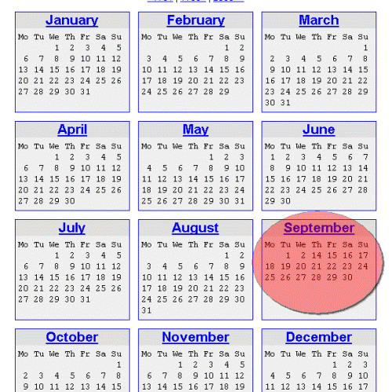
The big question is:
#1
THE CALENDAR WAS CHANGED!
Was the day of the week changed as a result?

Slide 18
The change of the calendar!
The new calendar was instituted when Gregory decreed, by the papal bull Inter gravissimas of 24 February 1582, that the day after Thursday, 4 October 1582 would be not Friday, 5 October, but Friday, 15 October 1582.
The new calendar duly replaced the Julian calendar, in use since 45 BC, and has since come into universal use. Because of Gregory's involvement, the reformed Julian calendar came to be known as the Gregorian calendar.
This could be obtained from many other sources but was “Googled” and taken from “Wikipedia”.
Notes:
Bull - An official order or proclamation issued by the / a Pope. The bull / document usually has a name or title. // Was the order of the day of the week change? Did Friday still follow Thursday?

Slide 19
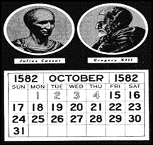
Was the day of the week changed?
So, the big question is:
Notes:
So, was the weekly cycle of days affected or lost? Answer: NO
(Julius Caesar - 1582

Slide 20
Note on Calendar change:
NOT EVERY COUNTRY OR GROUP OF NATIONS ACCEPTED THE CHANGE OF CALENDAR AT THE SAME TIME!!
Double Dating
Between 1582 and 1752 (170 yrs.), not only were two calendars in use in Europe (and in European colonies), but two different starts of the year were in use in England. Although the "Legal" year began on March 25, the use of the Gregorian calendar by other European countries led to January 1 becoming commonly celebrated as "New Year's Day" and given as the first day of the year in almanacs.
To avoid misinterpretation, both the "Old Style" and "New Style" year was often used in English and colonial records for dates falling between the new New Year (January 1) and old New Year (March 25), a system known as "double dating."
Source: http://www.cslib.org/CalendarChange.htm#WhichCalendar

Slide 21
Further Note on Calendar change:
The Changes of 1752
In accordance with a 1750 act of Parliament, England and its colonies changed calendars in 1752. By that time, the discrepancy between a solar year and the Julian Calendar had grown by an additional day, so that the calendar used in England and its colonies was 11 days out-of-sync with the Gregorian Calendar in use in most other parts of Europe.
England's calendar change included three major components. The Julian Calendar was replaced by the Gregorian Calendar, changing the formula for calculating leap years. The beginning of the legal new year was moved from March 25 to January 1. Finally, 11 days were dropped from the month of September 1752.
The changeover involved a series of steps:
December 31, 1750 was followed by January 1, 1750 (under the "Old Style" calendar, December was the 10th month and January the 11th)
March 24, 1750 was followed by March 25, 1751 (March 25 was the first day of the "Old Style" year)
December 31, 1751 was followed by January 1, 1752 (the switch from March 25 to January 1 as the first day of the year)
September 2, 1752 was followed by September 14, 1752 (drop of 11 days to conform to the Gregorian calendar)
England accepted the change of calendar in 1752 and had to make adjustments that were necessary by then.
None of the adjustments affected the weekly cycle!!

Slide 22
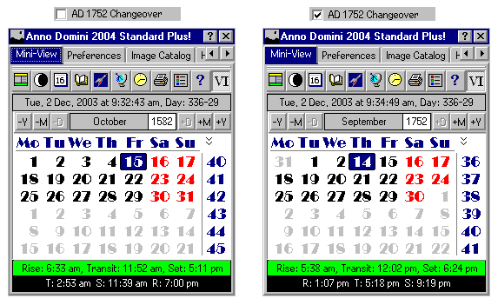
#2
The big question is:
Was the day of the week changed in any of the calendars?

Slide 23
Part 2 of the question:
“…over the years we have lost sight of which day is the seventh day?”
Short answer:
“NO.” (We have not lost sight of the days of the week; we tried to show that earlier.)
Answer from an Astronomer:
“In spite of all of our dickerings with the calendar, it is patent that the human race never lost the septenary [seven-day] sequence of week days and that the Sabbath of these latter times comes down to us from Adam, through the ages, without a single lapse.” Dr. Totten of New Haven, Connecticut—Professor of Astronomy, Yale University
Did the calendar change result in man losing sight of which day is the seventh day?
Note: The non-S.D.A. Source proceeded to seek to prove the statement true in a book entitled: “The Sabbath: Has Time Been Lost?” (PDF of book available; recommended reading!)
Source of quote: http://rcg/books/tshtbl.html
Not an S.D.A. Source.
Notes:
Check out the 1752 change!

Slide 24
Part 2 of the question:
Another Answer: The Jews and the Jamaican Context:
The Jews / Israelites were the ones to whom the commandments were given on two tables of stone. The Jews have kept the Sabbath every 7th day down through the ages!
Here’s the Jamaica case…
“…over the years we have lost sight of which day is the seventh day?”
Note: If one Jew or family of Jews or even a set of families forgot the Sabbath one could understand – But not an entire nation; though scattered far and wide at one point in time.
Notes:
Check out the 1752 change!

Slide 25
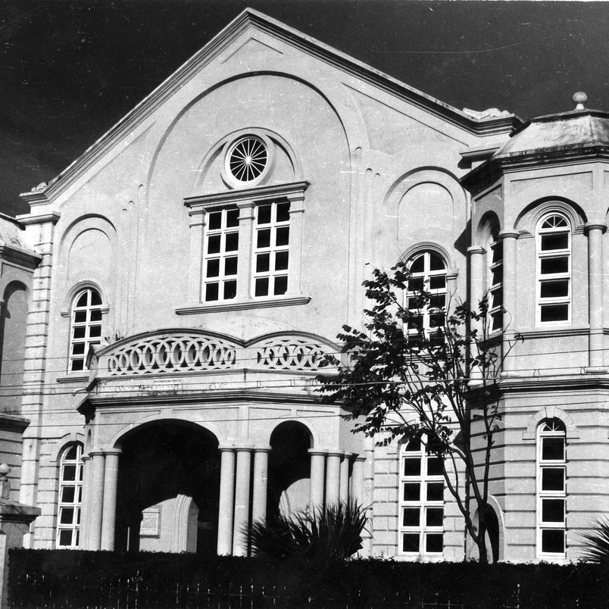
Jewish Synagogue (United Congregation of Israelites) Duke Street, Kingston, Jamaica
Some History:
The synagogue “Shaangare Shalom” – Gates of Peace – in downtown Kingston. “Now the only Jewish place of worship in Jamaica". It was built in 1912 replacing an earlier 1881 building that was destroyed in the earthquake of 1907. There were originally two Jewish congregations in Kingston – the Sephardim and the Ashkenazim, representing Jews of Mediterranean and Middle European origins respectively.
Source: http://www.flickr.com/photos/28320522@N08/2643129156/
PAUSE

Slide 26
(3) So, how is it so many persons go to church on Sunday?
Notes:
Question 1: Which day is the 7th day? Q. 2: “Wasn’t the calendar changed and over the years we have lost sight of which day is the seventh day?”
Answer:
1. It can be as easy and simple as counting from 1 to 7, beginning with the 1st day of the week – Sunday!
2. The Sabbath was established by God from Creation Week
3. In Creation Week the Bible calls the days of the week – “the evening and the morning was the first day”, etc.
4. In ancient times as man worshipped false gods or idols and the heavenly bodies they named the days of the week according to the names of their gods and the level of power ascribed to those gods – but the seven-day weekly cycle had never changed…
5. The weekly cycle of days was never broken even though there were a number of calendar changes throughout history.
6. The fact that the Jews still observe Sabbath on Saturday is an indisputable fact that Saturday is the seventh day, the same day that God called Sabbath in the 4th commandment in the Decalogue.
ESTABLISH THE CONNECTION BETWEEN THE UNMASKING OF THE FALSE SABBATH WITH THE MESSAGE OF THE FIRST ANGEL (EXO 20:11 & REV 14:7)

Slide 27
Exo. 20:11 cf rev 14:7
11 For in six days the Lord MADE heaven and earth, the sea, and all that in them is, and rested the seventh day: wherefore the Lord blessed the sabbath day, and hallowed it.
7 Saying with a loud voice, Fear God, and give glory to him; for the hour of his judgment is come: and worship him that MADE heaven, and earth, and the sea, and the fountains of waters.
Notes:
Q - WHY SHOUD WE CARE WHICH DAY IS OBSERVED AS THE SABBATH? AND WHY SHOULD WE CARE THAT SO MANY PERSONS GOING TO CHURCH / WORSHIPPING GOD ON SUNDAYS?
BECAUSE GOD CARES AND HE SHOWS IT BY PUTTING IT IN THE VERY WORDS HE USED IN HIS END OF TIME GOSPEL MESSAGE TO MANKIND! IT – IS – ALL – ABOUT – WORSHIP!! AND GOD DESIRES TRUE WORSHIP!!
John 4: 23 and 24 - But the hour cometh, and now is, when the true worshippers shall worship the Father in spirit and in truth: for the Father seeketh such to worship him. 24 God is a Spirit: and they that worship him must worship him in spirit and in truth. / AND THE TRUTH IS THAT SATURDAY IS THE SABBATH, THE SEVENTH DAY OF THE WEEK!!

Slide 28
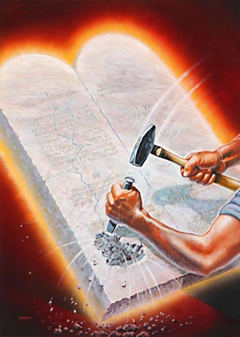
(3) So, how is it so many persons go to church on Sunday?
The short answer to that is simply: Because many persons have forgotten the true Sabbath, the day that God says to “Remember” and has chosen to keep Sunday instead.
Short answer.
Isaiah 58:13,14
Notes:
WHY IS THAT SO? BECAUSE MANY PERSONS DO NOT READ THE BIBLE! THE BIBLE IS THE SOURCE OF TRUTH!!
Isaiah 58: 13 If thou turn away thy foot from the sabbath, from doing thy pleasure on my holy day; and call the sabbath a delight, the holy of the Lord, honourable; and shalt honour him, not doing thine own ways, nor finding thine own pleasure, nor speaking thine own words: 14 Then shalt thou delight thyself in the Lord; and I will cause thee to ride upon the high places of the earth, and feed thee with the heritage of Jacob thy father: for the mouth of the Lord hath spoken it.

Slide 29
(3) So, how is it so many persons go to church on Sunday?
Another short answer to that is simply:
Because many persons just follow what other people do!
Short answer.
Isaiah 58:13,14
Notes:
WHY IS THAT SO? BECAUSE MANY PERSONS DO NOT READ THE BIBLE! THE BIBLE IS THE SOURCE OF TRUTH!!

Slide 30
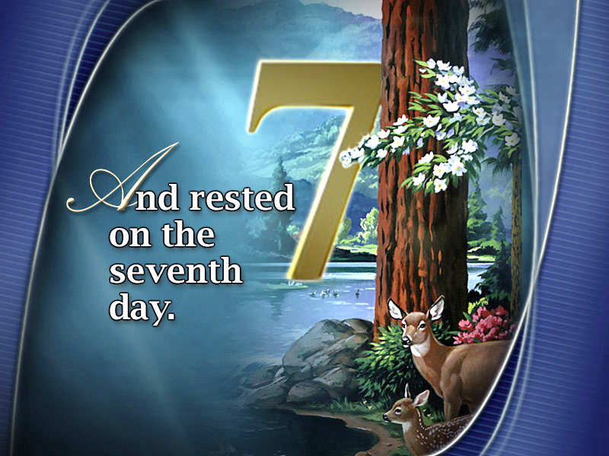
(3) So, how is it so many persons go to church on Sunday?
Yes, there are some who simply do not know that Sunday is not the Sabbath and who have been following their parents or grandparents or others in keeping Sunday.
So…
Acts 17:30
Some are just plain ignorant of the truth.
Notes:
Some say: Me born come see mi family, mi mother, mi father, mi grandmother a dweet! OR some say “Mi Pastor seh.”
Acts 17:30 {KJV) And the times of this ignorance God winked at; but now commandeth all men every where to repent:

Slide 31
(3) So, how is it so many persons go to church on Sunday?
We will seek to answer this question briefly by looking at facts that will reveal the following:
(a) The history of Sunday – keeping and the first Sunday law;
(b) The keeping of the “Sunday – Sabbath” alongside the true Sabbath and the popularization of the “Sunday – Sabbath”.
Listeners & readers are strongly encouraged to go and search & study this matter for themselves – as also all the other areas we have & will mention.
Components of the answer.
Notes:
The best we can do in these meetings is to expose you to some of the things concerning the subject!

Slide 32
The history of Sunday – keeping and the first Sunday law, etc.
In order to understand this, we must understand what happened in that early church soon after the apostles passed off the stage of action. Paul had prophesied that apostasy would take place soon after his departure. He said there would be a falling away from the truth. (Acts 20:28-31) One doesn’t have to read very far in early church history to see just how that prophecy was fulfilled.
1. Gnosticism began to rise up under the influence of philosophers who sought to reconcile Christianity with Paganism.
2. At the same time, a strong anti-Jewish sentiment became more widespread.
3. Very speculative interpretations began to appear regarding some of the great doctrines of Christ and the apostles.
Source / Recommended website:
www.sabbathtruth.com
Notes:
Acts 20:28-31 (KJV) ²⁸ Take heed therefore unto yourselves, and to all the flock, over the which the Holy Ghost hath made you overseers, to feed the church of God, which he hath purchased with his own blood. ²⁹ For I know this, that after my departing shall grievous wolves enter in among you, not sparing the flock. ³⁰ Also of your own selves shall men arise, speaking perverse things, to draw away disciples after them. ³¹ Therefore watch, and remember, that by the space of three years I ceased not to warn every one night and day with tears.
The doctrine of salvation by knowledge. This definition, based on the etymology of the word (gnosis "knowledge", gnostikos, "good at knowing"), is correct as far as it goes, but it gives only one, though perhaps the predominant, characteristic of Gnostic systems of thought. Whereas Judaism and Christianity, and almost all pagan systems, hold that the soul attains its proper end by obedience of mind and will to the Supreme Power, i.e. by faith and works, it is markedly peculiar to Gnosticism that it places the salvation of the soul merely in the possession of a quasi-intuitive knowledge of the mysteries of the universe and of magic formulae indicative of that knowledge. Gnostics were "people who knew", and their knowledge at once constituted them a superior class of beings, whose present and future status was essentially different from that of those who, for whatever reason, did not know. A more complete and historical definition of Gnosticism would be: A collective name for a large number of greatly-varying and pantheistic-idealistic sects, which flourished from some time before the Christian Era down to the fifth century, and which, while borrowing the phraseology and some of the tenets of the chief religions of the day, and especially of Christianity, held matter to be a deterioration of spirit, and the whole universe a depravation of the Deity, and taught the ultimate end of all being to be the overcoming of the grossness of matter and the return to the Parent-Spirit, which return they held to be inaugurated and facilitated by the appearance of some God-sent Saviour.

Slide 33
The history of Sunday – keeping and the first Sunday law, etc.
The Conversion of Constantine
By the time Constantine was established as the emperor of Rome in the early fourth century, there was a decided division in the church as a result of all these factors. I think you might know that, Constantine was the first (so-called) Christian emperor of the Roman Empire.
Source / Recommended website: www.sabbathtruth.com
For likely emphasis in Part 2
Notes:
“So-called” – Because there has been debate for centuries whether the conversion was a true conversion.

Slide 34
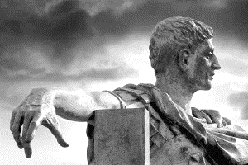
The history of Sunday – keeping and the first Sunday law, etc.
"On the Venerable Day of the Sun ["venerabili die Solis"--the sacred day of the Sun] let the magistrates and people residing in cities rest, and let all workshops be closed. In the country, however, persons engaged in agriculture may freely and lawfully continue their pursuits; because it often happens that another day is not so suitable for grain-sowing or for vine-planting; lest by neglecting the proper moment for such operations the bounty of heaven should be lost--Given the 7th day of March, [A.D. 321], Crispus and Constantine being consuls each of them for the second time." The First Sunday Law of Constantine 1, in "Codex Justinianus," lib. 3, tit. 12, 3; trans. in Phillip Schaff "History of the Christian Church," Vol. 3, p. 380. Source: http://www.remnantofgod.org/321AD.htm
Source / Recommended website: www.sabbathtruth.com
For likely emphasis in Part 2
Notes:
In modern times, In the 1930’s when the “Great Depression” hit, the people living in the cities experience the full brunt of the suffering.

Slide 35
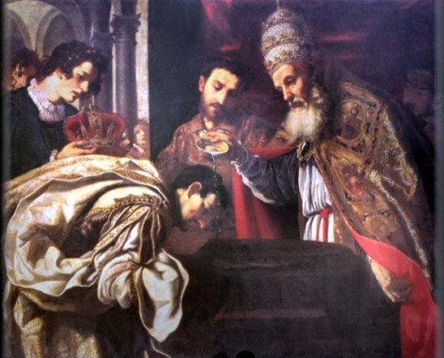
The history of Sunday – keeping and the first Sunday law, etc.
Constantine declared all his pagan soldiers to be Christians, and became very zealous to build up the power and prestige of the church. Through his influence great blocks of pagans were taken into the Christian ranks. But, friends, they were still pagan at heart, and they brought in much of the paraphernalia of sun-worship to which they continued to be devoted. At the same time, many other customs were Christianized** and appropriated into the practice of the church as well.
Pope Saint Sylvester “baptizing” Constantine the Great.
Source / Recommended website:
www.sabbathtruth.com
Notes:
** Example: “Dem bless pork and call it Arnold”. OR Like taking the dog house, pig pen, goat pen, etc. and put in your house.
The doctrine of salvation by knowledge. This definition, based on the etymology of the word (gnosis "knowledge", gnostikos, "good at knowing"), is correct as far as it goes, but it gives only one, though perhaps the predominant, characteristic of Gnostic systems of thought. Whereas Judaism and Christianity, and almost all pagan systems, hold that the soul attains its proper end by obedience of mind and will to the Supreme Power, i.e. by faith and works, it is markedly peculiar to Gnosticism that it places the salvation of the soul merely in the possession of a quasi-intuitive knowledge of the mysteries of the universe and of magic formulae indicative of that knowledge. Gnostics were "people who knew", and their knowledge at once constituted them a superior class of beings, whose present and future status was essentially different from that of those who, for whatever reason, did not know. A more complete and historical definition of Gnosticism would be:
A collective name for a large number of greatly-varying and pantheistic-idealistic sects, which flourished from some time before the Christian Era down to the fifth century, and which, while borrowing the phraseology and some of the tenets of the chief religions of the day, and especially of Christianity, held matter to be a deterioration of spirit, and the whole universe a depravation of the Deity, and taught the ultimate end of all being to be the overcoming of the grossness of matter and the return to the Parent-Spirit, which return they held to be inaugurated and facilitated by the appearance of some God-sent Saviour.

Slide 36
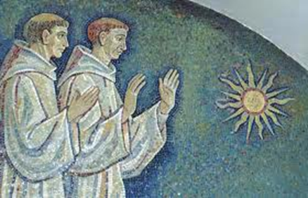
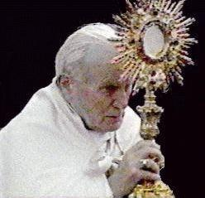
The history of Sunday – keeping and the first Sunday law, etc.
Sun Worship (Mithraism)
You see, at that time the cult of Mithraism or sun-worship was the official religion of the Roman Empire. It stood as the greatest competitor to the new Christian religion. It had its own organization, temples, priesthood, robes—everything. It also had an official worship day on which special homage was given to the sun. That day was called “The Venerable Day of the Sun.” It was the first day of the week, and from it we get our day name “Sunday”.
Source / Recommended website:
www.sabbathtruth.com
Notes:
REACH HERE

Slide 37
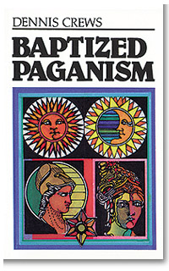
The history of Sunday – keeping and the first Sunday law, etc.
When Constantine pressed his pagan hordes into the church they were observing the day of the sun for their adoration of the sun god. It was their special holy day. In order to make it more convenient for them to make the change to the new religion, Constantine accepted their day of worship, Sunday, instead of the Christian Sabbath which had been observed by Jesus and His disciples.
Source / Recommended website:
www.sabbathtruth.com
Notes:
“A suh di ting did set” – So, it came down to nowadays.

Slide 38
The history of Sunday – keeping and the first Sunday law, etc.
Remember that the way had been prepared for this already by the increasing anti-Jewish feelings against those who were accused of putting Jesus to death. Those feelings would naturally condition many Christians to swing away from something which was held religiously by the Jews. It is therefore easier to understand how the change was imposed on Christianity through a strong civil law issued by Constantine as the Emperor of Rome.
Source / Recommended website:
www.sabbathtruth.com
(Dan. 7:25)

Slide 39
The history of Sunday – keeping and the first Sunday law, etc.
The very wording of that law, by the way, can be found in any reliable encyclopedia. Those early Christians, feeling that the Jews should not be followed any more than necessary, were ready to swing away from the Sabbath which was kept by the Jews. After Constantine made the initial pronouncement and legal decree about the change, the Catholic Church reinforced that act in one church council after another. For this reason, many, many official statements from Catholic sources are made, claiming that the church made the change from Saturday to Sunday**.
Source / Recommended website:
www.sabbathtruth.com
PAUSE
Notes:
**The Catholic Church is proud of the fact that they changed the Sabbath from Saturday to Sunday – Or, so they say! (Dan. 7:25)

Slide 40
(4) So, what do the Sunday - keeping churches have to say about the keeping of Sunday?

Slide 41
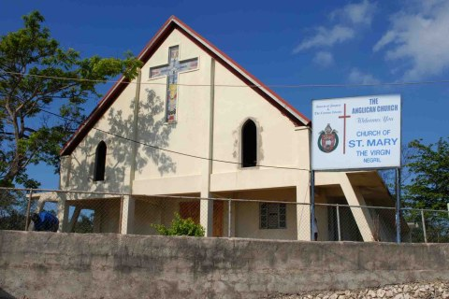
(4) So, what do the Sunday churches have to say about the keeping of Sunday?
ANGLICAN:
"And where are we told in the Scriptures that we are to keep the first day at all? We are commanded to keep the seventh; but we are nowhere commanded to keep the first day... The reason why we keep the first day of the week holy instead of the seventh is for the same reason that we observe many other things, not because the Bible, but because the Church, has enjoined it." Isaac Williams, Plain Sermons on the Catechism, pages 334, 336.
MAJOR DENOMINATIONS ONLY. MAJOR QUOTE(S) ONLY.
OFFICIAL STATEMENTS OF THE DENOMINATION OR ITS REPRESENTATIVES OR AUTHORS
Notes:
To save time only major denominations and major quotes will be used. A primtout of a full document with the

Slide 42
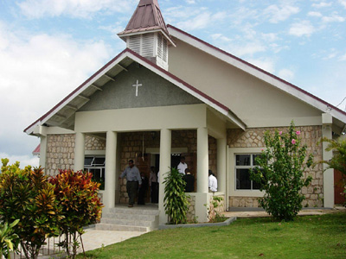
(4) So, what do the Sunday churches have to say about the keeping of Sunday?
“There was and is a command to keep holy the Sabbath day, but that Sabbath day was not Sunday. It will however be readily said, and with some show of triumph, that the Sabbath was transferred from the seventh to the first day of the week, with all its duties, privileges and sanctions. Earnestly desiring information on this subject, which I have studied for many years, I ask, where can the record of such a transaction be found: Not in the New Testament – absolutely not. There is no scriptural evidence of the change of the Sabbath institution from the seventh to the first day of the week.” Dr. E. T. Hiscox, author of the ‘Baptist Manual’
BAPTIST:
MAJOR DENOMINATIONS ONLY. MAJOR QUOTE(S) ONLY.
OFFICIAL STATEMENTS OF THE DENOMINATION OR ITS REPRESENTATIVES OR AUTHORS

Slide 43
(4) So, what do the Sunday churches have to say about the keeping of Sunday?
"The Scriptures nowhere call the first day of the week the Sabbath. . .There is no Scriptural authority for so doing, nor of course, any Scriptural obligation." The Watchman.
"We believe that the law of God is the eternal and unchangeable rule of His moral government."-"Baptist Church Manual," Art. 12.
"There is nothing in Scripture that requires us to keep Sunday rather than Saturday as a holy day." Harold Lindsell (editor), Christianity Today, Nov. 5, 1976
BAPTIST:
MAJOR DENOMINATIONS ONLY. MAJOR QUOTE(S) ONLY.
OFFICIAL STATEMENTS OF THE DENOMINATION OR ITS REPRESENTATIVES OR AUTHORS

Slide 44
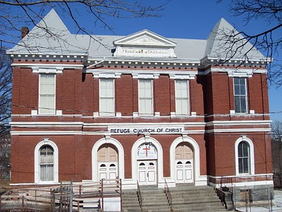
(4) So, what do the Sunday churches have to say about the keeping of Sunday?
"... If the fourth command is binding upon us Gentiles by all means keep it. But let those who demand a strict observance of the Sabbath remember that the seventh day is the ONLY sabbath day commanded, and God never repealed that command. If you would keep the Sabbath, keep it; but Sunday is not the Sabbath. The argument of the 'Seventh-day Adventists' is on one point unassailable. It is the Seventh day not the first day that the command refers to."
G. Alridge, Editor, The Bible Standard, April, 1916
CHURCH OF CHRIST:
MAJOR DENOMINATIONS ONLY. MAJOR QUOTE(S) ONLY.
OFFICIAL STATEMENTS OF THE DENOMINATION OR ITS REPRESENTATIVES OR AUTHORS

Slide 45
(4) So, what do the Sunday churches have to say about the keeping of Sunday?
"The first day of the week is commonly called the Sabbath. This is a mistake. The Sabbath of the Bible was the day just preceding the first day of the week. The first day of the week is never called the Sabbath anywhere in the entire Scriptures. It is also an error to talk about the change of the Sabbath. There never was any change of the Sabbath from Saturday to Sunday. There is not in any place in the Bible any intimation of such a change."-
"First-Day Observance," pages 17, 19
CHURCH OF CHRIST:
MAJOR DENOMINATIONS ONLY. MAJOR QUOTE(S) ONLY.
OFFICIAL STATEMENTS OF THE DENOMINATION OR ITS REPRESENTATIVES OR AUTHORS

Slide 46
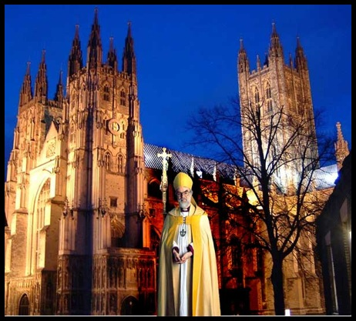
(4) So, what do the Sunday churches have to say about the keeping of Sunday?
CHURCH OF ENGLAND:
"Many people think that Sunday is the Sabbath. But neither in the New Testament nor in the early church is there anything to suggest that we have any right to transfer the observance of the seventh day of the week to the first. The Sabbath was and is Saturday and not Sunday, and if it were binding on us then we should observe it on that day, and on no other." Rev. Lionel Beere, All-Saints Church, Ponsonby, N.Z. in Church and People, Sept. 1, 1947
MAJOR DENOMINATIONS ONLY. MAJOR QUOTE(S) ONLY.
OFFICIAL STATEMENTS OF THE DENOMINATION OR ITS REPRESENTATIVES OR AUTHORS

Slide 47
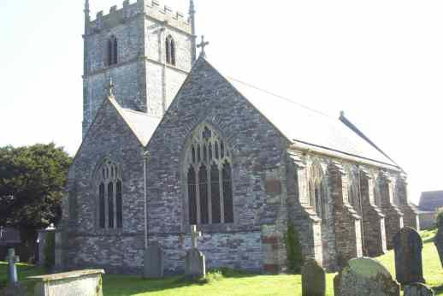
(4) So, what do the Sunday churches have to say about the keeping of Sunday?
CHURCH OF ENGLAND:
"Nowhere in the Bible is it laid down that worship should be done on Sunday. Remember the Sabbath day to keep it holy. ...! That is Saturday." P. Carrington, Archbishop of Quebec, Oct. 27, 1949; cited in Prophetic Signs, p 12
"Sunday being the day on which the Gentiles solemnly adore that planet and called it Sunday, partly from its influence on that day especially, and partly in respect to its divine body (as they conceived it), the Christians thought fit to keep the same day and the same name of it, that they might not appear causelessly peevish, and by that means hinder the conversion of the Gentiles, and bring a greater prejudice than might be otherwise taken against the gospel."- T. M. MORER, "Dialogues on the Lord's Day," pages 22, 23
MAJOR DENOMINATIONS ONLY. MAJOR QUOTE(S) ONLY.
OFFICIAL STATEMENTS OF THE DENOMINATION OR ITS REPRESENTATIVES OR AUTHORS

Slide 48
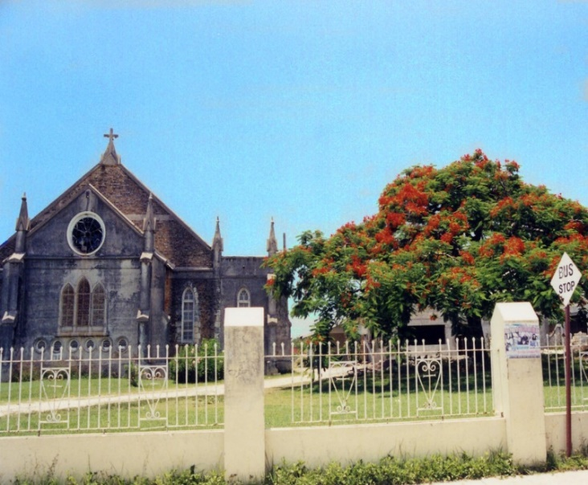
(4) So, what do the Sunday churches have to say about the keeping of Sunday?
"In the days of very long ago the people of the world began to give names to everything, and they turned the sounds of the lips into words, so that the lips could speak a thought. In those days the people worshipped the sun because many words were made to tell of many thoughts about many things. The people became Christians and were ruled by an emperor whose name was Constantine. This emperor made Sunday the Christian Sabbath, because of the blessing of light and heat which came from the sun. So our Sunday is a sun-day, isn't it?“ -Sunday School Advocate, Dec. 31, 1921
METHODIST:
MAJOR DENOMINATIONS ONLY. MAJOR QUOTE(S) ONLY.
OFFICIAL STATEMENTS OF THE DENOMINATION OR ITS REPRESENTATIVES OR AUTHORS

Slide 49
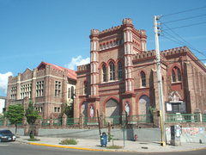
(4) So, what do the Sunday churches have to say about the keeping of Sunday?
METHODIST:
"The moral law contained in the Ten Commandments, and enforced by the prophets, He [Christ] did not take away. It was not the design of His coming to revoke any part of this. This is a law which never can be broken... Every part of this law must remain in force upon all mankind and in all ages; as not depending either on time or place, or any other circumstances liable to change, but on the nature of God and the nature of man, and their unchangeable relation to each other."- JOHN WESLEY, "Sermons on Several Occasions," Vol. I, Sermon XXV
MAJOR DENOMINATIONS ONLY. MAJOR QUOTE(S) ONLY.
OFFICIAL STATEMENTS OF THE DENOMINATION OR ITS REPRESENTATIVES OR AUTHORS

Slide 50
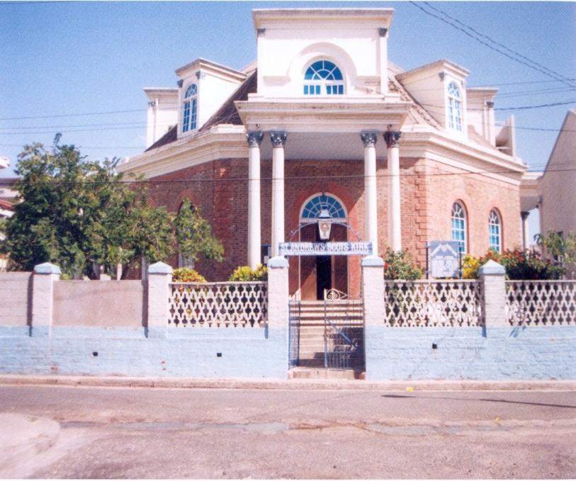
(4) So, what do the Sunday churches have to say about the keeping of Sunday?
PRESBYTERIAN:
"The Christian Sabbath (Sunday) is not in the Scriptures, and was not by the primitive church called the Sabbath." Dwight's Theology, Vol. 14, p. 401
"The observance of the seventh-day Sabbath did not cease till it was abolished after the [Roman] empire became Christian," ¬ American Presbyterian Board of Publication, Tract No. 118
"There is no word, no hint in the New Testament about abstaining from work on Sunday. The observance of Ash Wednesday, or Lent, stands exactly on the same footing as the observance of Sunday. Into the rest of Sunday no Divine Law enters." Canon Eyton, in The Ten Commandments
MAJOR DENOMINATIONS ONLY. MAJOR QUOTE(S) ONLY.
OFFICIAL STATEMENTS OF THE DENOMINATION OR ITS REPRESENTATIVES OR AUTHORS

Slide 51
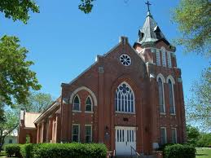
(4) So, what do the Sunday churches have to say about the keeping of Sunday?
LUTHERAN:
"The observance of the Lord's Day (Sunday) is founded not on any command of God, but on the authority of the Church." Augsburg Confession of Faith
"The festival of Sunday, like all other festivals, was always only a human ordinance."- AUGUSTUS NEANDER, "History of the Christian Religion and Church," Vol. 1, page 186.
MAJOR DENOMINATIONS ONLY. MAJOR QUOTE(S) ONLY.
OFFICIAL STATEMENTS OF THE DENOMINATION OR ITS REPRESENTATIVES OR AUTHORS
Notes:
Augsburg Confession, Latin Confessio Augustana , the 28 articles that constitute the basic confession of the Lutheran churches, presented June 25, 1530, in German and Latin at the Diet of Augsburg to the emperor Charles V by seven Lutheran princes and two imperial free cities. // The primary confession of faith of the Lutheran Church and one of the most important documents of the Lutheran Reformation. // King Charles V – Coronated by Pope Pius VI, 1530,
So VERY sad that it has been planned, by the Catholic Church and the Lutheran Church, along with others, that on October 1. 2017 on the 500th Anniversary of the start of the Protest by Martin Luther - to officially REJECT that Confession, to show that the Lutheran Church, officially, no longer believe what their founder, Martin Luther believed but instead accept to be fully part of the Catholic led ecumenical system.

Slide 52
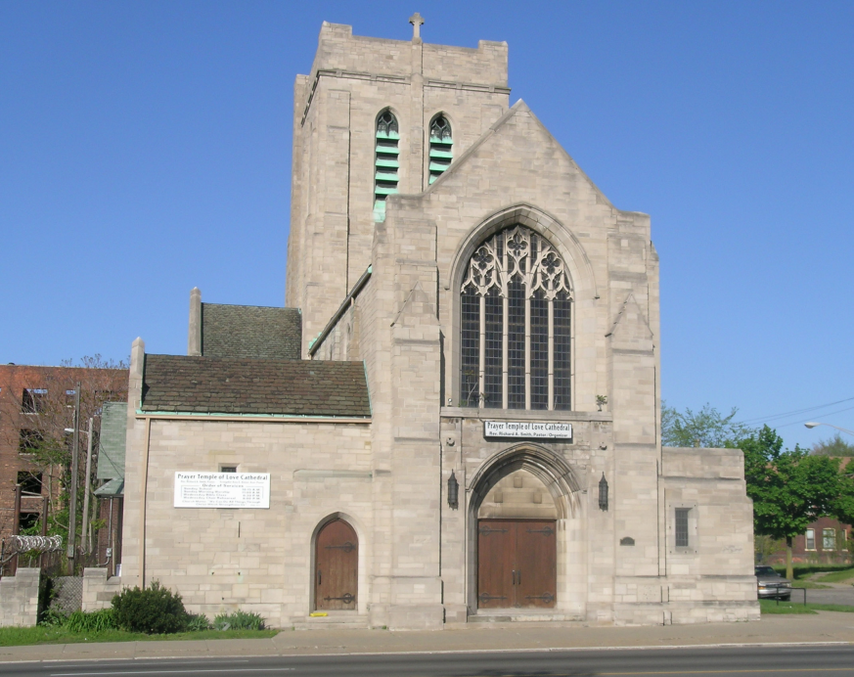
(4) So, what do the Sunday churches have to say about the keeping of Sunday?
LUTHERAN:
"The Christians in the ancient church very soon distinguished the first day of the week, Sunday; however, not as a Sabbath, but as an assembly day of the church, to study the Word of God together, and to celebrate the ordinances one with another: without a shadow of doubt, this took place as early as the first part of the second century."- Bishop GRIMELUND, "History of the Sabbath," page 60
MAJOR DENOMINATIONS ONLY. MAJOR QUOTE(S) ONLY.
OFFICIAL STATEMENTS OF THE DENOMINATION OR ITS REPRESENTATIVES OR AUTHORS

Slide 53
http://www.sabbathtruth.com/
There are a lot more!
God bless!
PAUSE

Slide 54
(5) But, I heard that the change of the day is in the Bible!!
Isn’t it?

Slide 55
(5) But, I heard that the change of the day is in the Bible!! Isn’t it?
AS MENTIONED EARLIER, THE WORD “SUNDAY” DOES NOT APPEAR IN THE BIBLE BUT THE PHRASE: “THE FIRST DAY OF THE WEEK.”
THIS PHRASE IS MENTIONED EIGHT (8) TIMES IN THE BIBLE. SO, IF THERE WAS A CHANGE IT WOULD BE MENTIONED IN AT LEAST ONE OF THOSE TEXTS. SO, AS WE LOOK AT THESE TEXTS, LET US ASK THE QUESTION:
“DOES IT SAY THAT THE SABBATH IS NOW CHANGED TO THE FIRST DAY OF THE WEEK?”

Slide 56
(5) But, I heard that the change of the day is in the Bible!! Isn’t it?
Here’s # ONE!
MATTHEW 28:1
In the end of the sabbath, as it began to dawn toward the first day of the week, came Mary Magdalene and the other Mary to see the sepulchre.
DOES THIS TEXT SAY THE SEVENTH DAY SABBATH WAS CHANGED TO SUNDAY, THE FIRST DAY OF THE WEEK?

Slide 57
(5) But, I heard that the change of the day is in the Bible!! Isn’t it?
Here’s # TWO!
MARK 16:2
And very early in the morning the first day of the week, they came unto the sepulchre at the rising of the sun.
See Verse 1
DOES THIS TEXT SAY THE SEVENTH DAY SABBATH WAS CHANGED TO SUNDAY, THE FIRST DAY OF THE WEEK?
Notes:
Note: Verse 1 actually proves that the first day of the week (Sunday) – could never be the Sabbath! One of the texts that will be included as we go further into Part 2 on revealing the true Sabbath – i.e. Using the texts surrounding Jesus’ death, burial and resurrection to prove that Saturday is indeed the Sabbath.

Slide 58
(5) But, I heard that the change of the day is in the Bible!! Isn’t it?
Here’s # THREE!
MARK 16:9
Now when Jesus was risen early the first day of the week, he appeared first to Mary Magdalene, out of whom he had cast seven devils.
DOES THIS TEXT SAY THE SEVENTH DAY SABBATH WAS CHANGED TO SUNDAY, THE FIRST DAY OF THE WEEK?

Slide 59
(5) But, I heard that the change of the day is in the Bible!! Isn’t it?
Here’s # FOUR!
LUKE 24:1
Now upon the first day of the week, very early in the morning, they came unto the sepulchre, bringing the spices which they had prepared, and certain others with them.
See Chapter 23, Verses 54-56
DOES THIS TEXT SAY THE SEVENTH DAY SABBATH WAS CHANGED TO SUNDAY, THE FIRST DAY OF THE WEEK?
Notes:
Note: We will explore Luke 23: 54 – 56, etc. in Part 2 of the study!

Slide 60
(5) But, I heard that the change of the day is in the Bible!! Isn’t it?
Here’s # FIVE!
JOHN 20:1
The first day of the week cometh Mary Magdalene early, when it was yet dark, unto the sepulchre, and seeth the stone taken away from the sepulchre.
DOES THIS TEXT SAY THE SEVENTH DAY SABBATH WAS CHANGED TO SUNDAY, THE FIRST DAY OF THE WEEK?

Slide 61
(5) But, I heard that the change of the day is in the Bible!! Isn’t it?
Here’s # SIX!
JOHN 20:19
Then the same day at evening, being the first day of the week, when the doors were shut where the disciples were assembled for fear of the Jews, came Jesus and stood in the midst, and saith unto them, Peace be unto you.
[Did Jesus say: “I have changed the Sabbath to the first day of the week.”? / Did the text say: “While they were at worship”? OR “While they were having service”? OR While they were praising God”?]
DOES THIS TEXT SAY THE SEVENTH DAY SABBATH WAS CHANGED TO SUNDAY, THE FIRST DAY OF THE WEEK?
Notes:
Note: Some persons use this text to say that this was a Sunday service or meeting being held by the disciples. Was that the case? // Why were the disciples assembled “for fear of the Jews”? / Why did Jesus say “Peace be unto you”? / The two previous verses: 17 Jesus saith unto her, Touch me not; for I am not yet ascended to my Father: but go to my brethren, and say unto them, I ascend unto my Father, and your Father; and to my God, and your God. 18 Mary Magdalene came and told the disciples that she had seen the Lord, and that he had spoken these things unto her. – This meeting was Sunday evening at any rate!

Slide 62
(5) But, I heard that the change of the day is in the Bible!! Isn’t it?
Here’s # SEVEN!
ACTS 20:7
See Acts 2:46
And upon the first day of the week, when the disciples came together to break bread, Paul preached unto them, ready to depart on the morrow; and continued his speech until midnight.
DOES THIS TEXT SAY THE SEVENTH DAY SABBATH WAS CHANGED TO SUNDAY, THE FIRST DAY OF THE WEEK?
Notes:
Acts 2:46 And they, continuing daily with one accord in the temple, and breaking bread from house to house, did eat their meat with gladness and singleness of heart, 47 Praising God, and having favour with all the people. And the Lord added to the church daily such as should be saved.

Slide 63
(5) But, I heard that the change of the day is in the Bible!! Isn’t it?
Here’s # EIGHT!
1 CORINTHIANS 16:2
Upon the first day of the week let every one of you lay by him in store, as God hath prospered him, that there be no gatherings when I come.
DOES THIS TEXT SAY THE SEVENTH DAY SABBATH WAS CHANGED TO SUNDAY, THE FIRST DAY OF THE WEEK?
Notes:
1 Cor. 16:1 Now concerning the collection for the saints, as I have given order to the churches of Galatia, even so do ye.

Slide 64

(5) But, I heard that the change of the day is in the Bible!! Isn’t it?
SO, THE ANSWER IS…?
PAUSE
Notes:
There is nowhere in the scriptures that support the idea that the seventh-day Sabbath is Sunday / the first day of the week.

Slide 65
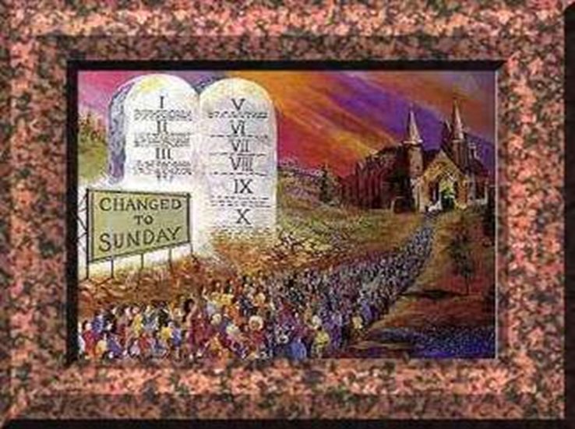
(6) By the way; you mentioned that the Roman Catholic Church changed the day. What proof do you have for that? What does the Roman Catholic Church say about the change of the Sabbath?

Slide 66
Catholic quotes from important sources:
DANIEL 7:25
“It is well to remind the Presbyterians, Baptists, Methodists, and all other Christians, that the Bible does not support them anywhere in their observance of Sunday. Sunday is an institution of the Roman Catholic Church, and those who observe the day observe a commandment of the Catholic Church.” Priest Brady, in an address, reported in the Elizabeth, NJ ‘News’ on March 18, 1903.
"Protestants ... accept Sunday rather than Saturday as the day for public worship after the Catholic Church made the change... But the Protestant mind does not seem to realize that ... in observing Sunday, they are accepting the authority of the spokesman for the Church, the pope." Our Sunday Visitor, February 5th, 1950.
Notes:
Daniel 7:25
And he shall speak great words against the most High, and shall wear out the saints of the most High, and think to change times and laws: and they shall be given into his hand until a time and times and the dividing of time.

Slide 67

Catholic quotes from important sources:
Q. Have you any other way of proving that the Church has power to institute festivals of precept?
DANIEL 7:25
A. Had she not such power, she could not have done that in which all modern religionists agree with her; —she could not have substituted the observance of Sunday the first day of the week, for the observance of Saturday the seventh day, a change for which there is no Scriptural authority.
Rev. Stephen Keenan, A Doctrinal Catechism; New York in 1857, page 174

Slide 68

Catholic quotes from important sources:
Question: Which is the Sabbath day?
Answer: Saturday is the Sabbath day.
Question: Why do we observe Sunday instead of Saturday?
Answer: We observe Sunday instead of Saturday because the Catholic Church transferred the solemnity from Saturday to Sunday.
Rev. Peter Geiermann C.SS.R., The Convert’s Catechism of Catholic Doctrine, p. 50
DANIEL 7:25
Notes:
Catechism:
An elementary book containing a summary of the principles of the Christian religion, especially as maintained by a particular church, in the form of questions and answers.
Solemnity
- the state or quality of being serious and dignified. / synonyms: dignity, ceremony, stateliness, courtliness, majesty, impressiveness, portentousness, splendour, magnificence, grandeur, importance, augustness, formality; solemnness "the solemnity of the occasion“.

Slide 69
Catholic quotes from important sources:
DANIEL 7:25
"The Church, on the other hand, after changing the day of rest from the Jewish Sabbath, or seventh day of the week, to the first, made the Third Commandment refer to Sunday as the day to be kept holy as the Lord's Day. The Council of Trent (Sess. VI, can. xix) condemns those who deny that the Ten Commandments are binding on Christians.”
The Catholic Encyclopedia, Commandments of God, Volume IV, © 1908 by Robert Appleton Company, Online Edition © 1999 by Kevin Knight, Nihil Obstat - Remy Lafort, Censor Imprimatur - +John M. Farley, Archbishop of New York, page 153.
Notes:
Imprimatur: An official licence issued by the Roman Catholic Church to print an ecclesiastical or religious book. //"the imprimatur for this edition was granted by Cardinal O'Casey“
Nihil - Latin, literally "nothing" (see nil). Phrase nihil obstat "nothing stands in the way" printed on first pages of a Catholic work indicates its official approval.
Nihil obstat (Latin for "nothing hinders" or "nothing stands in the way") is a declaration of no objection to an initiative or an appointment. Apart from this general sense, the phrase is used more particularly to mean an "attestation by a church censor that a book contains nothing damaging to faith or morals".

Slide 70
Bible Ten Commandments |  | Catholic Ten Commandments
1st | I am the LORD thy God, which have brought thee out of the land of Egypt, out of the house of bondage. Thou shalt have no other gods before me. | 1st | I am the LORD thy God. Thou shalt have no strange gods before Me.
2nd | Thou shalt not make unto thee any graven image, or any likeness of any thing that is in heaven above, or that is in the earth beneath, or that is in the water under the earth. Thou shalt not bow down thyself to them, nor serve them: for I the Lord thy God am a jealous God, visiting the iniquity of the fathers upon the children unto the third and fourth generation of them that hate me; And shewing mercy unto thousands of them that love me, and keep my commandments. |  | Commandment deleted. (See also idolatry in the Catholic Church.) (There is idolatry in the Papal system so the second Commandment has been deleted or sometimes it has been absorbed into the first. All remaining Commandments are therefore shifted along one count.)
3rd | Thou shalt not take the name of the LORD thy God In vain; for the LORD will not hold him guiltless that taketh his name in vain. | 2nd | Thou shalt not take the name of the LORD thy God in vain.
4th | Remember the sabbath day, to keep it holy. Six days shalt thou labour, and do all thy work: 10 But the seventh day is the sabbath of the Lord thy God: in it thou shalt not do any work, thou, nor thy son, nor thy daughter, thy manservant, nor thy maidservant, nor thy cattle, nor thy stranger that is within thy gates: 11 For in six days the Lord made heaven and earth, the sea, and all that in them is, and rested the seventh day: wherefore the Lord blessed the sabbath day, and hallowed it. | 3rd | Remember to keep holy the Sabbath day. (The Sabbath is the fourth Commandment by normal count. The day to be kept is no longer mentioned since they changed the Sabbath to Sunday) (Note that God had more to say about the fourth Commandment than all others and with good reason. It is very important.)
5th | Honour thy father and thy mother: that thy days may be long upon the land which the LORD thy God giveth thee. | 4th | Honour thy father and thy mother.
6th | Thou shalt not kill. | 5th | Thou shalt not kill.
7th | Thou shalt not commit adultery. | 6th | Thou shalt not commit adultery.
8th | Thou shalt not steal. | 7th | Thou shalt not steal.
9th | Thou shalt not bear false witness against thy neighbour. | 8th | Thou shalt not bear false witness against thy neighbour.
10th | Thou shalt not covet thy neighbour's house, thou shalt not covet thy neighbour's wife, nor his manservant, nor his maidservant, nor his ox, nor his ass, nor any thing that is thy neighbour's. | 9th | Thou shalt not covet thy neighbour's wife. (The Tenth Commandment is split into two to get back to Ten Commandments.)
 |  | 10th | Thou shalt not covet thy neighbour's goods.

Slide 71
Catholic quotes from important sources:
DANIEL 7:25
"Perhaps the boldest thing, the most revolutionary change the Church ever did, happened in the first century. The holy day, the Sabbath, was changed from Saturday to Sunday. "The Day of the Lord" (dies Dominica) was chosen, not from any directions noted in the Scriptures, but from the Church's sense of its own power. The day of resurrection, the day of Pentecost, fifty days later, came on the first day of the week. So this would be the new Sabbath. People who think that the Scriptures should be the sole authority, should logically become 7th Day Adventists, and keep Saturday holy."
Sentinel, Pastor's page, Saint Catherine Catholic Church, Algonac, Michigan, May 21, 1995
PAUSE

Slide 72
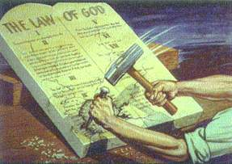
(7) Well, what if I just accept Sunday as my Sabbath and keep it holy – Because it is more convenient, and a better day for me to go to church?

Slide 73
(7) Well, what if I just accept Sunday as my Sabbath and keep it holy – Because it is more convenient, and a better day for me to go to church?
The commandment says:
Exodus 20:10 “But the seventh day is the sabbath of the LORD thy God:” & verse 8: “Remember the Sabbath day, to keep it holy.
SO: We cannot select a day for ourselves. The Bible says that the day is God’s day AND The seventh day Sabbath is the only holy day.
Notes:
If I choose a day to keep as my sabbath – That would be my sabbath, not God’s Sabbath. God created Sabbath and made it holy with His presence. We cannot make any day holy – and the Sabbath is not only about resting from secular work; it is to have communion with God. Also, in verse 8 the commandment starts with “REMEMBER”.

Slide 74
(7) Well, what if I just accept Sunday as my Sabbath and keep it holy – Because it is more convenient, and a better day for me to go to church?
It should not be a matter of convenience; it is not about what we want – It’s about obedience to Jesus!
Jesus said: “If ye love me, keep my commandments.” If we love Jesus as our Lord and Saviour we will be obedient to Him.
If we do what we please / what is convenient to us we only show that we are being disobedient. *This reminds one of Cain.
Notes:
Story of Cain in Genesis 4. (See next slide.)
1 Samuel 15:22 And Samuel said, Hath the Lord as great delight in burnt offerings and sacrifices, as in obeying the voice of the Lord? Behold, to obey is better than sacrifice, and to hearken than the fat of rams. It ought not to be about me/myself and I.

Slide 75
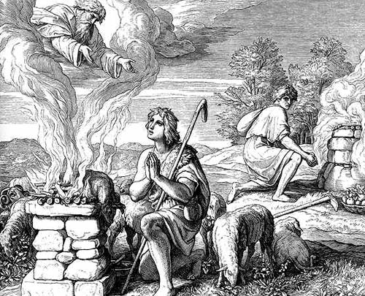
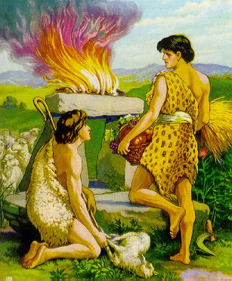
(7) Well, what if I just accept Sunday as my Sabbath and keep it holy – Because it is more convenient, and a better day for me to go to church?
PLASE GIVE WHAT GOD REQUIRES OF YOU
PAUSE
Genesis 4:1 - 8
Notes:
Cain’s story – See Genesis 4 (3 – 7). Cain became the first murderer consequent to his disobedience of convenience (giving God what he finds convenient and thinks God should accept; doing what he feels like doing! Is it possible that when we observe Sunday instead of Sabbath as God commanded we are doing just like Cain? Stubborn? Disobedient? Self-pleasing? When we do that do we end up crucifying Jesus afresh / being guilty of murdering Christ (because Sabbath – breaking is SIN). // Acts 17:30 (In the times of this ignorance God winked at but now commandeth all men everywhere to repent.)

Slide 76
(8) Well; can’t I keep Sunday in honor of Christ's resurrection?

Slide 77
(8) Well; can't I keep Sunday in honor of Christ's resurrection?
"Know ye not, that so many of us as were baptized into Jesus Christ were baptized into his death? Therefore we are buried with him by baptism into death: that like as Christ was raised up from the dead by the glory of the Father, even so we also should walk in newness of life. For if we have been planted together in the likeness of his death, we shall be also in the likeness of his resurrection: Knowing this, that our old man is crucified with him, that the body of sin might be destroyed, that henceforth we should not serve sin." Romans 6:3-6.
Notes:
The Apostle Paul is telling us what has been established as a symbol of Christ’s death, burial and resurrection – It is BAPTISM!! Nowhere in scripture do we see worshipping on Sunday being spoken of or established. We should let Jesus’ resurrection be the symbol for us overcoming sin in our lives / dead to sin and alive to Jesus Christ.

Slide 78
(8) Well; can't I keep Sunday in honor of Christ's resurrection?
Jesus’ resurrection is our surety of salvation. In other words, it is because Jesus was raised from the dead that it is made possible for us to be saved – it is what makes His death count!
Jesus died but was resurrected – that’s triumph over a death that was caused by your sin and mine; His death is payment for our sin.
To say we are going to honour Jesus’ resurrection by observing Sunday instead of keeping Saturday (the Sabbath) holy, is to sin.
1 John 3:4
Notes:
Hebrews 9:22 And almost all things are by the law purged with blood; and without shedding of blood is no remission.

Slide 79
So, the answer is:
No.
No more than you would keep Friday in place of the Sabbath in honor of the crucifixion. Would you? Christ gave the ordinance of baptism in honor of His death, burial, and resurrection. The Bible never suggests Sunday keeping in honor of the resurrection (nor for any other reason). We honor Christ by obeying Him, not by substituting man-made requirements in place of His.
Matthew 15:1-9 & Mark 7:1-13
Notes:
John 14:15 / 1 Samuel 15:22 / NOTE: Jesus set up the Lord’s Supper . Communion Service – To serve as a reminder of Him 1 Corinthians 11:23 – 27 /

Slide 80
(9) But, isn't Sunday the Lord's day?

Slide 81
(9) But, isn't Sunday the Lord's day?
Answer:
The Bible speaks of the “*Lord's day" in Revelation 1:10, so the Lord does have a special day. But no verse of Scripture refers to Sunday as the Lord's day. Rather, the Bible plainly identifies the Sabbath as the Lord's day. The only day ever blessed by the Lord or claimed by Him as His holy day is the seventh-day Sabbath.
Notes:
“ I was in the Spirit on the Lord's day, and heard behind me a great voice, as of a trumpet,” // Who spoke those words? (John) AND, Who was he calling the Lord?
Answer: (Rev. 1:1) The Revelation of Jesus Christ, which God gave unto him, to shew unto his servants things which must shortly come to pass; and he sent and signified it by his angel unto his servant John: (John is the servant of Jesus Christ – So, Jesus is his Master – OR, Lord.) So, which day could John call Jesus’ day? OR “the Lord’s day”? Luke 4:16, etc.

Slide 82
(9) But isn't Sunday the Lord's day?
Isaiah 58:13
“If thou turn away thy foot from the sabbath, from doing thy pleasure on my holy day; and call the Sabbath a delight, the holy of the Lord."
Matthew 12:8
"For the son of man is Lord even of the Sabbath day.”
VERY PLAIN
Notes:
The Lord calls the Sabbath “My Holy Day” – So, it is His, it is “The Lord’s Day” // If Jesus is the Lord of the Sabbath one can say the Sabbath is the Lord’s day or Jesus’ day.

Slide 83
(9) But isn't Sunday the Lord's day?
Mark 2:28
“Therefore the Son of man is Lord also of the Sabbath.”
Exodus 20:10
“But the seventh day is the Sabbath of the LORD thy God:”
VERY PLAIN
PAUSE
Notes:
NOTE: The seventh-day Sabbath is the Lord’s Day!

Slide 84
(10) The problem is, many persons believe certain things because the Pastor or Leader of their church said so.
How does God feel about religious leaders who ignore the Sabbath?

Slide 85
(10) The problem is, many persons believe certain things because the Pastor or Leader of their church said so. How does God feel about religious leaders who ignore the Sabbath?
READ EZEKIEL 22 V 26 - 31
Ezekiel 22:
26 "Her priests have violated my law, and have profaned mine holy things: they have put no difference between the holy and profane, neither have they shown difference between the holy and profane, neither have they shown difference between the unclean and the clean, and have hid their eyes from my Sabbaths, and I am profaned among them."
31 "Therefore have I poured out my indignation upon them;"
Notes:
Profane - Not relating to that which is sacred or religious; secular. "a talk that tackled topics both sacred and profane“ // synonyms:, lay, non-religious, non-church, temporal, worldly, earthly; unsanctified, unconsecrated, unhallowed. secular
Indignation - anger or annoyance provoked by what is perceived as unfair treatment. // synonyms: resentment, umbrage, affront, disgruntlement, anger, distress, unhappiness, discontent, dissatisfaction, displeasure, hurt, pain, upset, offence, pique, spleen, crossness, exasperation, vexation, irritation, annoyance, chagrin;

Slide 86
(10) The problem is, many persons believe certain things because the Pastor or Leader of their church said so. How does God feel about religious leaders who ignore the Sabbath?
READ EZEKIEL 22 V 26 - 31
Answer:
In hiding their eyes from God's true Sabbath, religious leaders offend the God of heaven. God promises punishment for such false shepherds. Millions have been misled on this matter. God cannot treat it lightly. Jesus condemned the Pharisees for pretending to love God while making void one of the Ten Commandments by their tradition (Read Mark 7:7-13). The same applies in this case.
Notes:
Amen!

Slide 87
(10) The problem is, many persons believe certain things because the Pastor or Leader of their church said so. How does God feel about religious leaders who ignore the Sabbath?
READ EZEKIEL 22 V 26 - 31
Another Answer:
Jesus said in Matthew 5:17 – 19:
¹⁷Think not that I am come to destroy the law, or the prophets: I am not come to destroy, but to fulfil.
¹⁸For verily I say unto you, Till heaven and earth pass, one jot or one tittle shall in no wise pass from the law, till all be fulfilled.
¹⁹Whosoever therefore shall break one of these least commandments, and shall teach men so, he shall be called the *least in the kingdom of heaven: but whosoever shall do and teach them, the same shall be called great in the kingdom of heaven.
Notes:
* Does this mean they will be in the Kingdom of God?

Slide 88
(10) The problem is, many persons believe certain things because the Pastor or Leader of their church said so. How does God feel about religious leaders who ignore the Sabbath?
JESUS IS OUR SAVIOUR, SHEPHERD AND LORD:
As Christians we should obey Jesus rather than our Leaders and Pastors.
If we follow Jesus we cannot go wrong!
See John 10: 26-28
Notes:
John 10: 26 But ye believe not, because ye are not of my sheep, as I said unto you. 27 My sheep hear my voice, and I know them, and they follow me: 28 And I give unto them eternal life; and they shall never perish, neither shall any man pluck them out of my hand. // AMEN!!!

Slide 89
Review / summary
“Settling the Saturday-Sunday Question: Unmasking the False Sabbath”…
SETTLED!?
Notes:
Q & A Session!

Slide 90
We showed:
The naming of the days of the week and the changes in the calendar did not change the weekly cycle of days.
Why Sunday observance is so popular today.
What the main Sunday Churches say about Sunday-keeping.
The Bible did not say the Sabbath was changed to Sunday.
The Sabbath to Sunday change was made by the Roman Catholic church and they acknowledge same.
The Sabbath is not and cannot be a day chosen to suit our own convenience but is the seventh day of the week.

Slide 91
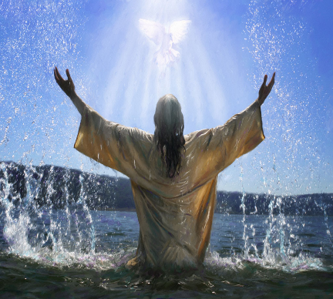
We showed the following:
Jesus gave baptism in honour of His resurrection, not the keeping of Sunday.
The Sabbath and not Sunday is “the Lord’s day”.
Leaders who ignore God’s law (His Sabbath) and make no difference between the profane and the holy will incur God’s indignation or wrath.
The seventh-day Sabbath was created and sanctified by God Himself and is a part of God’s ten commandments.
We must follow jesus & his inspired word – not leaders and pastors who might lead us astray.

Slide 92
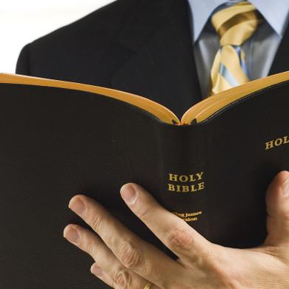
DEFENDING BY WRESTING THE SCRIPTURES
2 PETER 3:15 - 17
Notes:
WREST - to twist or turn from the proper course, application, use, meaning, or the like; wrench.

Slide 93
2 PETER 3:15 - 17
15 And account that the longsuffering of our Lord is salvation; even as our beloved brother Paul also according to the wisdom given unto him hath written unto you;
16 As also in all his epistles, speaking in them of these things; in which are some things hard to be understood, which they that are unlearned and unstable wrest, as they do also the other scriptures, unto their own destruction.
17 Ye therefore, beloved, seeing ye know these things before, beware lest ye also, being led away with the error of the wicked, fall from your own stedfastness.

Slide 94
ROMANS 14
⁵ One man esteemeth one day above another: another esteemeth every day alike. Let every man be fully persuaded in his own mind.
Notes:
Explain by the context. Which day is Paul talking about? Why did he mention one day above another? What was he talking about overall / what was his main point?

Slide 95
Hosea 2:11
I will also cause all her mirth to cease, her feast days, her new moons, and her sabbaths, and all her solemn feasts.

Slide 96
Colossians 2:16
Let no man therefore judge you in meat, or in drink, or in respect of an holyday, or of the new moon, or of the sabbath days:
¹⁷ Which are a shadow of things to come; but the body is of Christ.
Notes:
Present the context and show what Paul was really speaking about. Which sabbaths were regarded as shadows (types) of things to come? Why did Paul say “but the body is of Christ”? / Verse ¹⁴ Blotting out the handwriting of ordinances that was against us, which was contrary to us, and took it out of the way, nailing it to his cross;

Slide 97

conclusion
The False Sabbath Has Been SUFFICIENTLY UNMASKED!
Notes:
At least – For now / as much as we could.

Slide 98
conclusion
The False Sabbath Has Been SUFFICIENTLY UNMASKED!
A simple but yet profound fact that many miss in this issue is:
Since Sunday is the false Sabbath and is therefore not holy, it’s observance cannot fulfill the commandment; because the commandment says “Remember the Sabbath day to keep it holy”! Hallelujah!!!

Slide 99
conclusion
The False Sabbath Has Been SUFFICIENTLY UNMASKED!
If we keep the false Sabbath after we know it is false we show that we do not love Jesus and He is not our friend – although He desires both of us: In John 14:15 Jesus says: “If you love me, keep my commandments.” & in John 15:14 “You are my friends if you do whatsoever I command you.”
Moreover…

Slide 100
Please consider
God is LOVE (1 John 4:8 & 16)
Proverbs 28:9 says:
“He that turneth away his ear from hearing the law, even his prayer shall be abomination.”
Wow. This – is – a – serious text!
So, let us consider seriously what we are doing when (if) we reject any of God’s commandments.
OUR soul’s salvation depends on how we choose.
Notes:
James 2:10 For whosoever shall keep the whole law, and yet offend in one point, he is guilty of all.

Slide 101
appeal
# 1
Acts 17: 30, 31
30 And the times of this ignorance God winked at; but now commandeth all men every where to repent: 31 Because he hath appointed a day, in the which he will judge the world in righteousness by that man whom he hath ordained; whereof he hath given assurance unto all men, in that he hath raised him from the dead.

Slide 102
# 2
appeal
Joshua 24: 14 - 15
14 Now therefore fear the LORD, and serve him in sincerity and in truth: and put away the gods which your fathers served on the other side of the flood, and in Egypt; and serve ye the LORD. 15 And if it seem evil unto you to serve the LORD, choose you this day whom ye will serve; whether the gods which your fathers served that were on the other side of the flood, or the gods of the Amorites, in whose land ye dwell: but as for me and my house, we will serve the LORD.

Slide 103
# 3
appeal
Joshua 24: 16 - 18
16 And the people answered and said, God forbid that we should forsake the LORD, to serve other gods; 17 For the LORD our God, he it is that brought us up and our fathers out of the land of Egypt, from the house of bondage, and which did those great signs in our sight, and preserved us in all the way wherein we went, and among all the people through whom we passed: 18 And the LORD drave out from before us all the people, even the Amorites which dwelt in the land: therefore will we also serve the LORD; for he is our God.
Notes:
May this be the response of all who learn these truths!! Refer also to Elijah - 1 Kings 18:21 And Elijah came unto all the people, and said, How long halt ye between two opinions? if the Lord be God, follow him: but if Baal, then follow him. And the people answered him not a word.

Slide 104
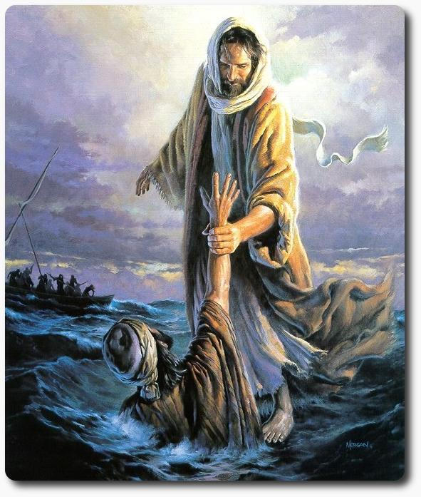
# 4
GOD LOVES ALL OF US AND WANTS TO SAVE US! HE HAS A WONDERFULLY GRAND KINGDOM PREPARED FOR US! HOWEVER, WE MUST CHOOSE TO SERVE GOD…REMEMBER REVELATION 22:14 SAYS: “BLESSED ARE THEY THAT DO HIS COMMANDMENTS THAT THEY MAY HAVE RIGHT TO THE TREE OF LIFE, AND MAY ENTER IN THROUGH THE GATES INTO THE CITY.”

